Slide 1
Timing and land cover validation with Planet; differentiating nonsoy agri vs SC and DC
March 15, 2019

Slide 2
Summary (for Sally; see details in the rest of the slides)

Slide 3
Planet image purchase approval?
QA on timing validation and timing estimate data to create timing validation map
Mask out timing validation data if it was a ‘guess’ (i.e. no Planet images for 2 months; reported data doesn’t match with EVI timeseries)
Mask out estimated timing if quarter period was not between 15 and 60; and if peaks were not between 1 and 300 days after Aug 1
Sources of error and bias
If there’s a sizeable (i.e. a month) bare soil gap between first and second crop, it’s easier to see p2 and h1; if they come very close together in time, they’re hard to separate in the MODIS timeseries (there’s just a gap of no data between h1 and p2), and it’s easy to get estimates wrong (and therefore will be masked out – source of bias?)
When there’s a short cycle ‘starter crop’ before the first crop, both the estimates and validation data get confused. This isn’t necessarily masked out in the estimates, because the resulting estimates might still be reasonable.

Slide 4
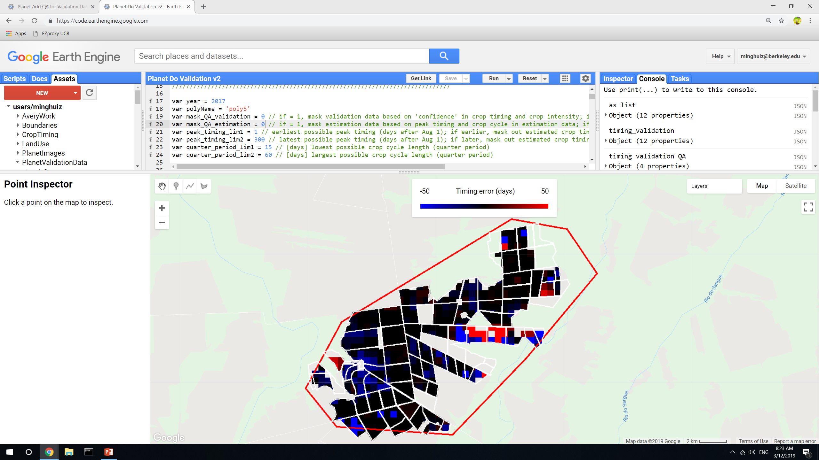
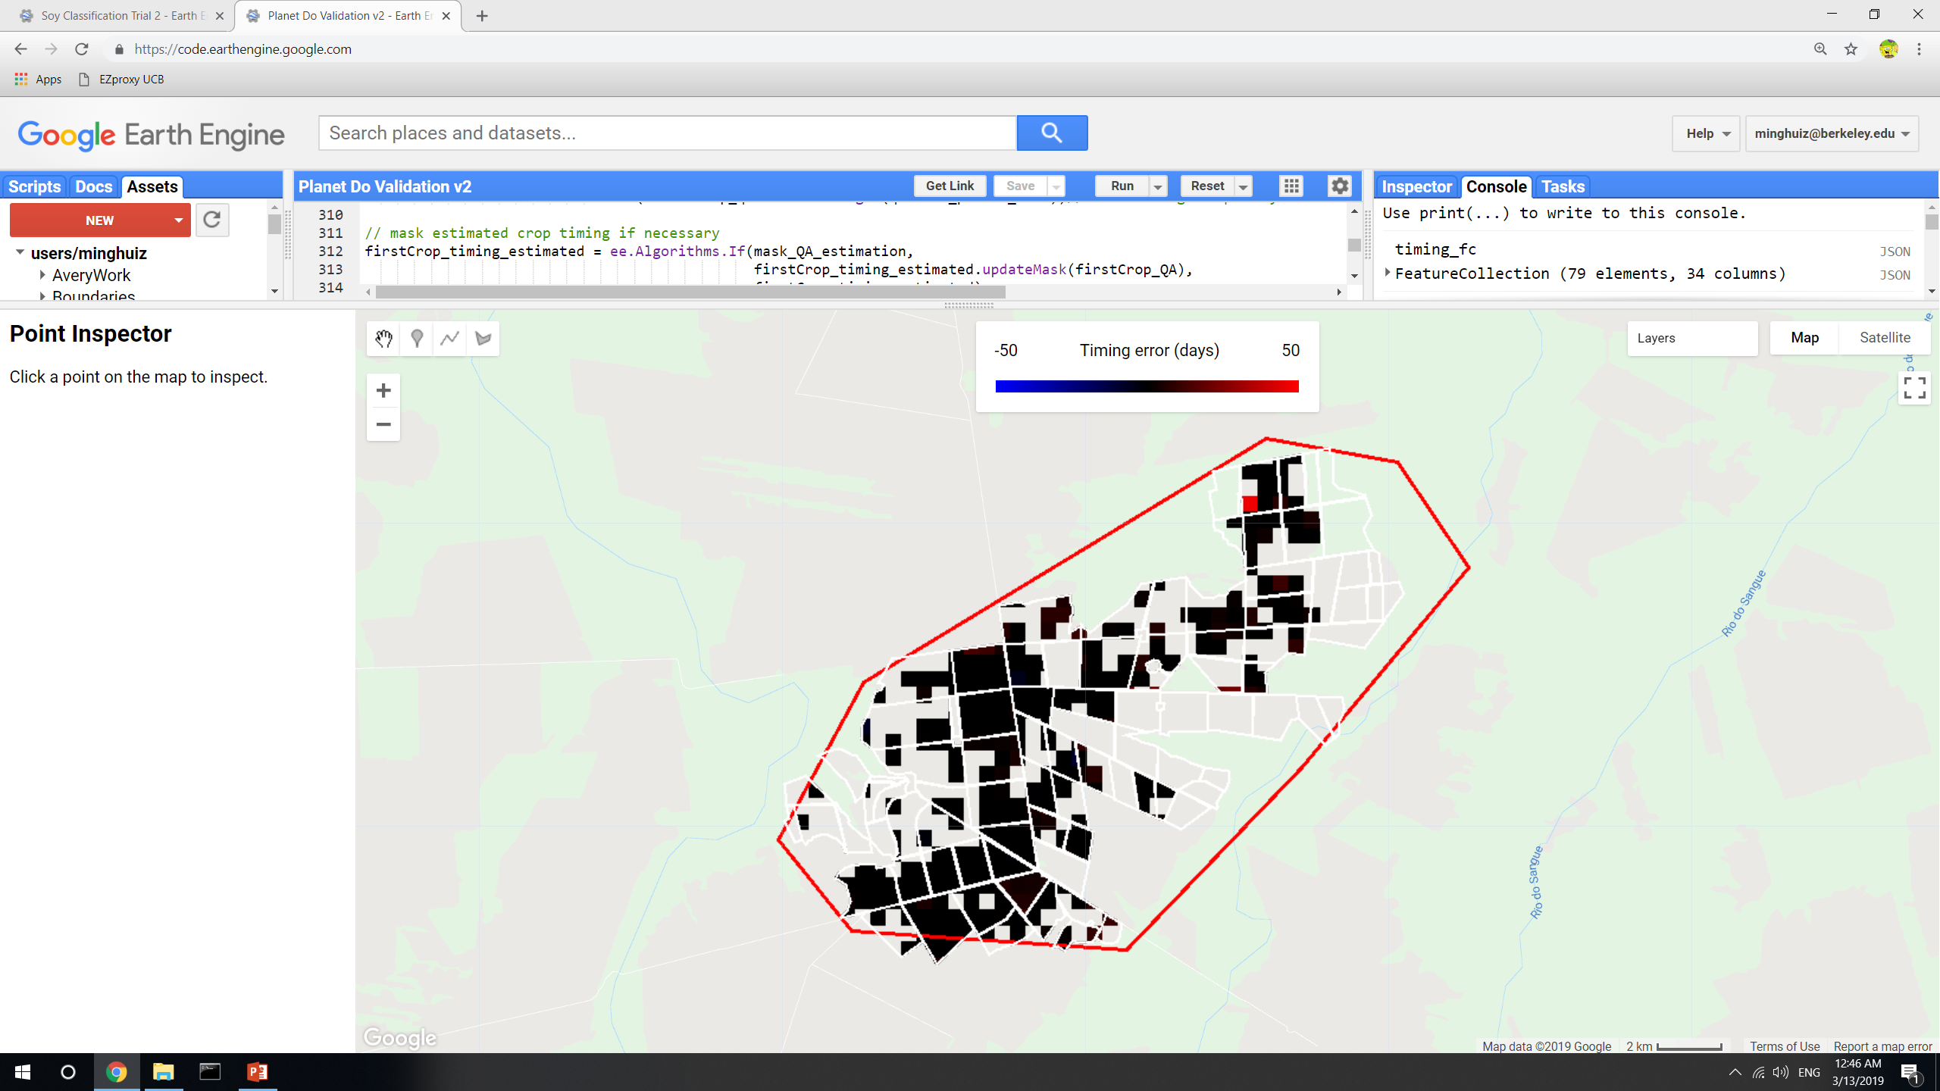
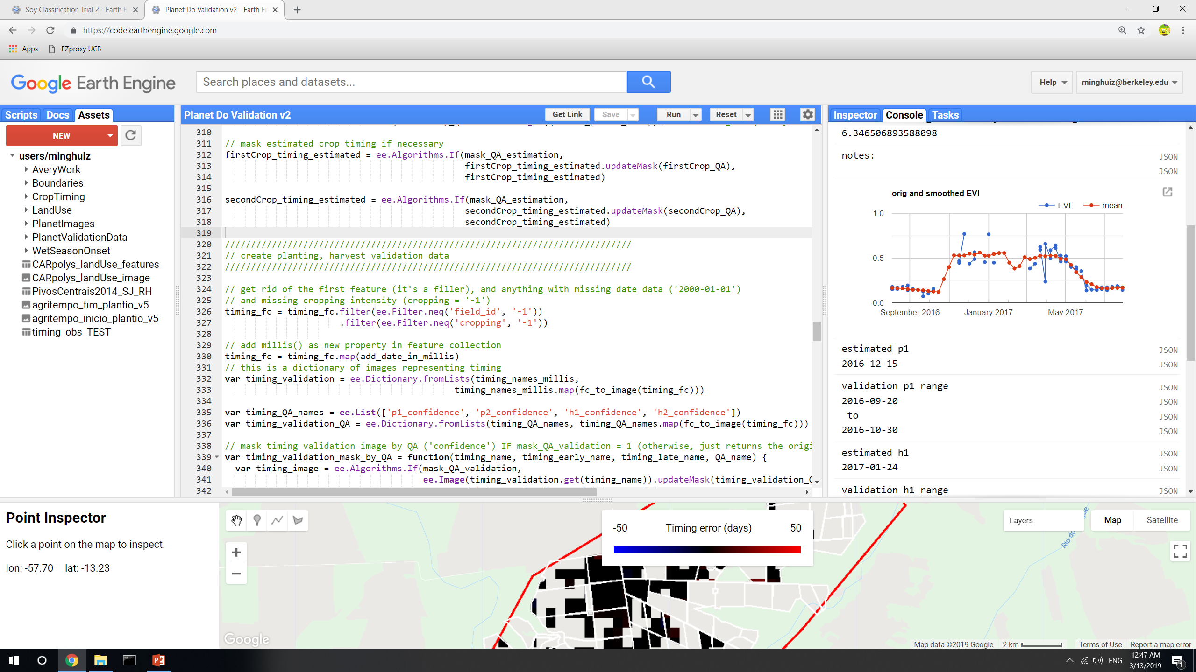
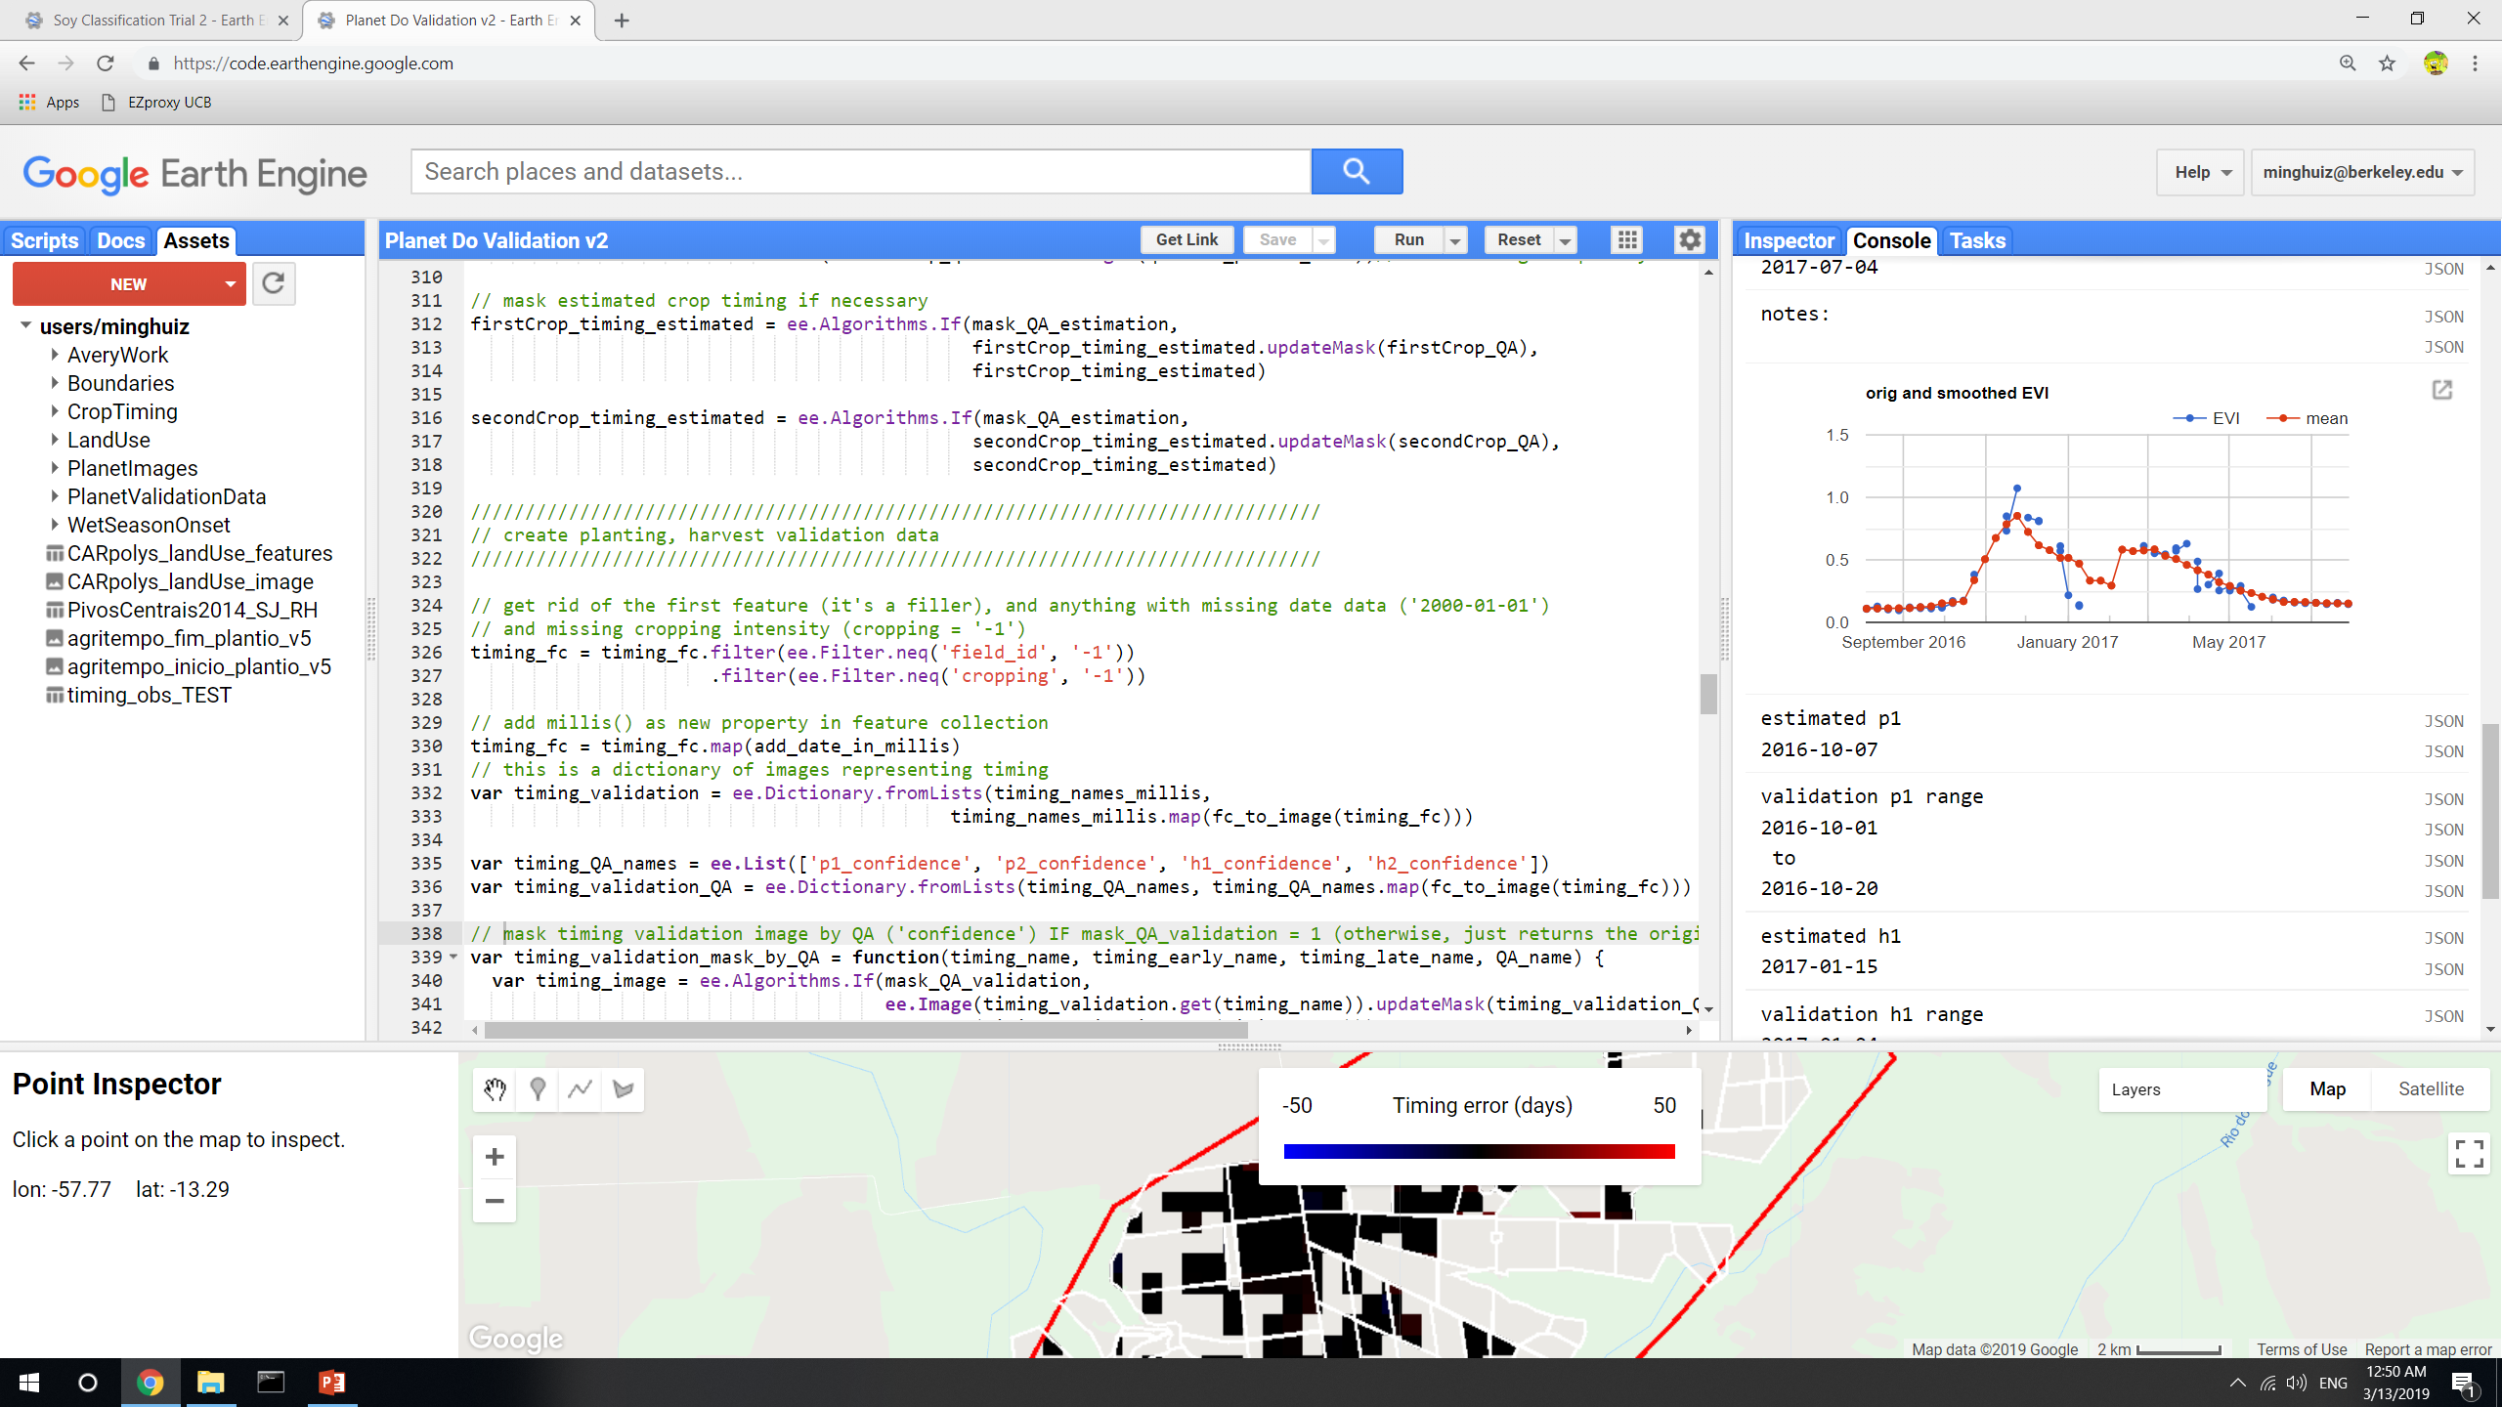
Poly5, 2017 before QA masking
Poly5, 2017, plant 1 after QA masking (of both pixel level estimates and entire fields based on validation data confidence)
Unsure why estimated planting was totally off
GEE file: LandCover/Planet Do Validation v2

Slide 5
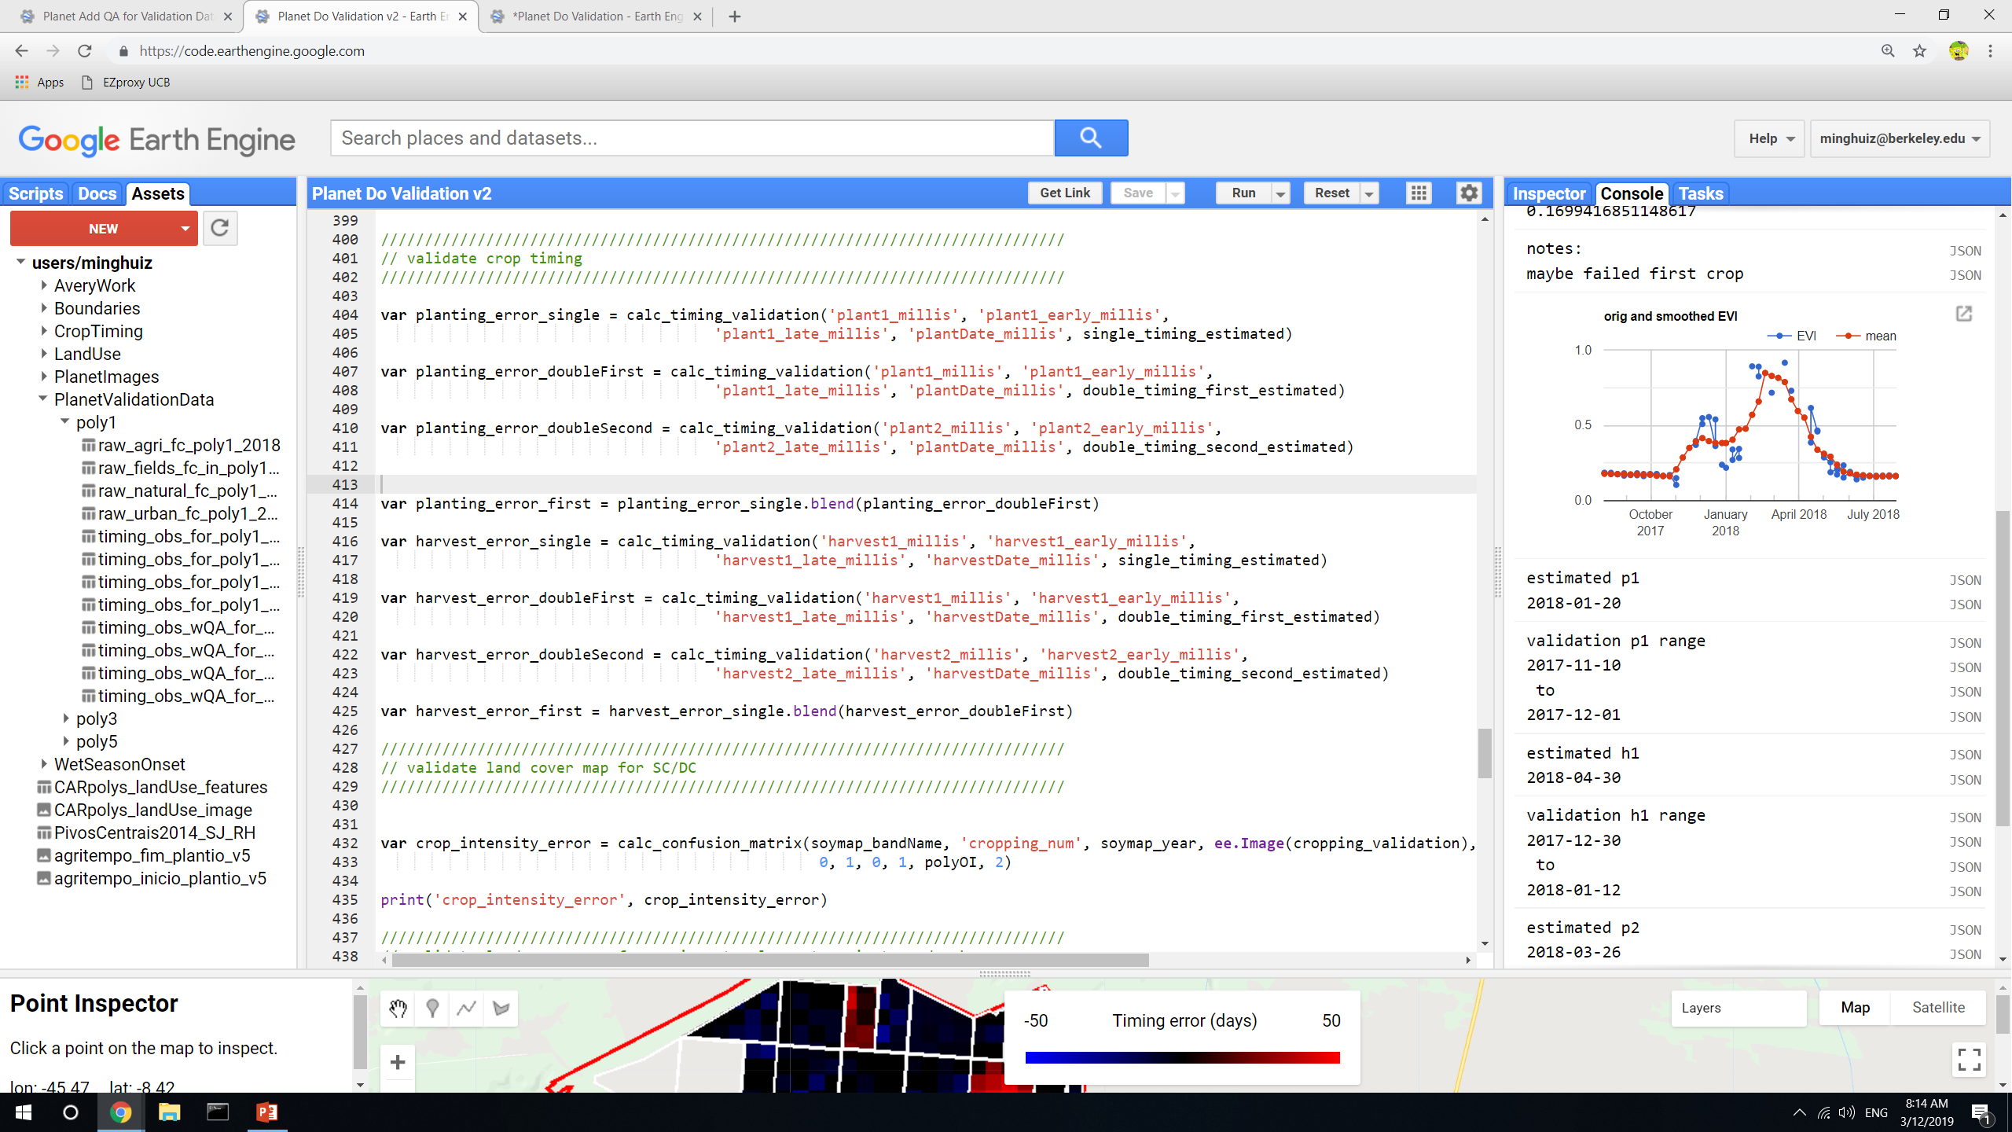
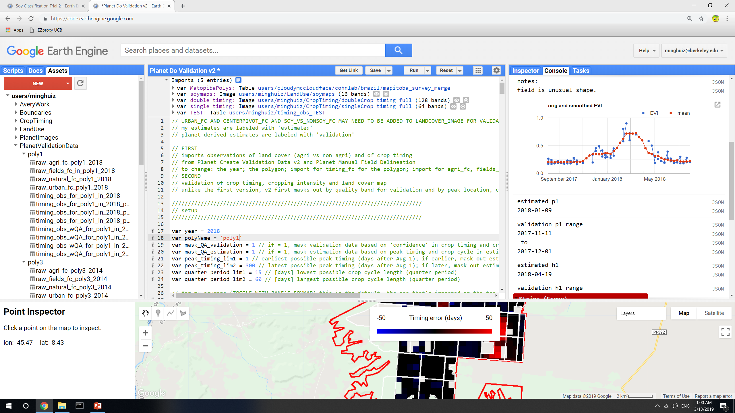
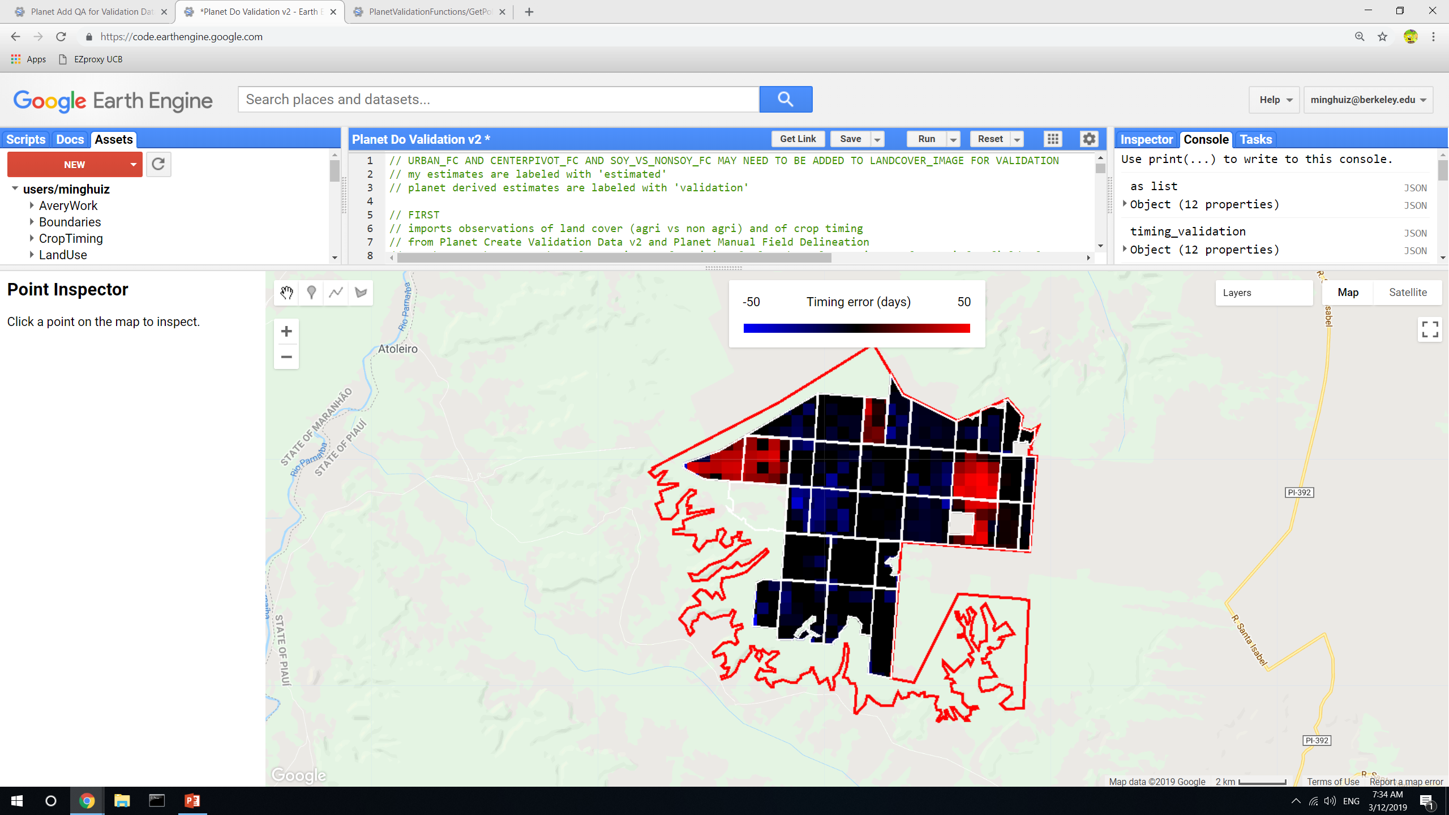
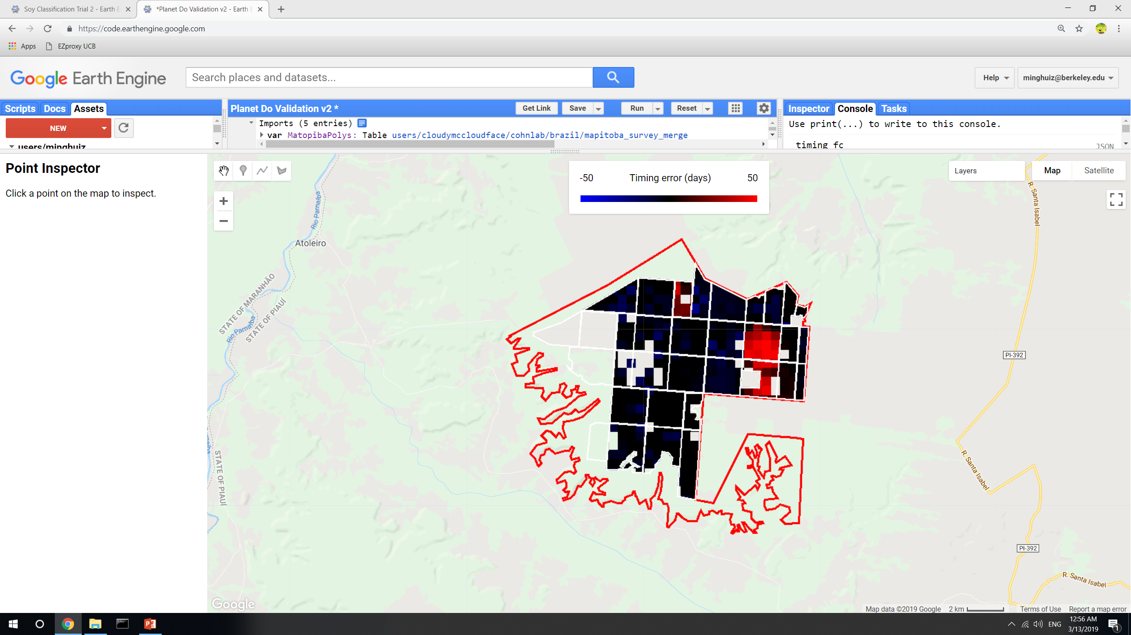
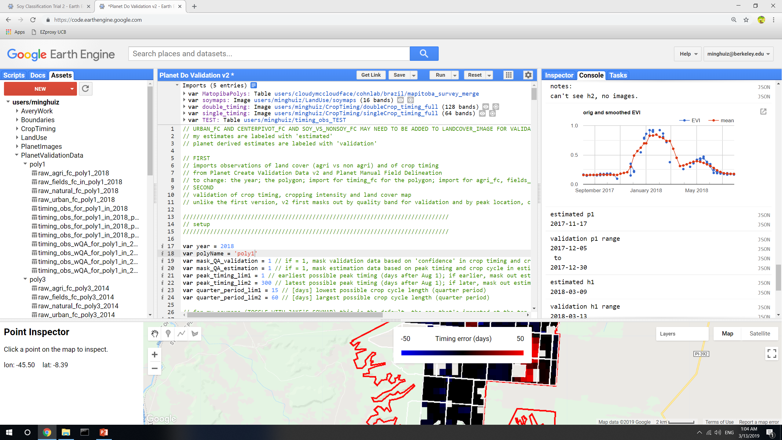
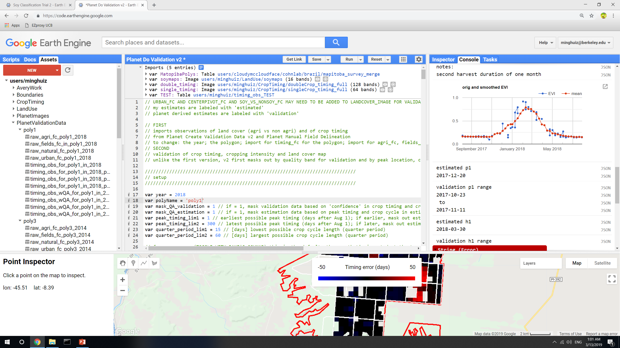
Poly1, 2018 before QA masking
Poly1, 2018, plant 1 after QA masking (of both pixel level estimates and entire fields based on validation data confidence)
Planting estimate mistook the second peak for the first peak
Planting estimate was probably better than validation data
GEE file: LandCover/Planet Do Validation v2

Slide 6
New soymaps (using additional training points beyond Jake’s method)
Pooling all years to train a single classifier
Adding PLOS training points
Notes
Soymap 2 does slightly better at classification than soymap 1 and Jake’s map
Accuracy in Matopiba is still low
 | Jake’s soymap | Soymap 1 | Soymap 2
GEE asset name | users/cloudymccloudface/cohnlab/agroserv/soy_sc_dc_agsat_mod_ls | Base_soymap_agsat_(year) for individual years soymap for image collection of all years | Base_soymap_agsat_PLOS_(year) for individual years Soymap_2 for image collection of all years
Training points | Soy_pts_agsat_1 (MT only) | Soy_pts_agsat_1 (MT only), masked with map3 agri | Soy_pts_agsat_1 (MT only), masked with map3 agri PLUS PLOS pts (MT only)
Year pooling | Each year has separate trained classifier | 2004-2017 points are pooled and are applied to 2004 – 2018; 2003 is trained and applied by itself | 2004-2017 points are pooled and are applied to 2004 – 2018; 2003 doesn’t have data yet
Input data | MODIS, Landsat | Same as Jake’s soymap | Same as Jake’s soymap MINUS Landsat bands

Slide 7
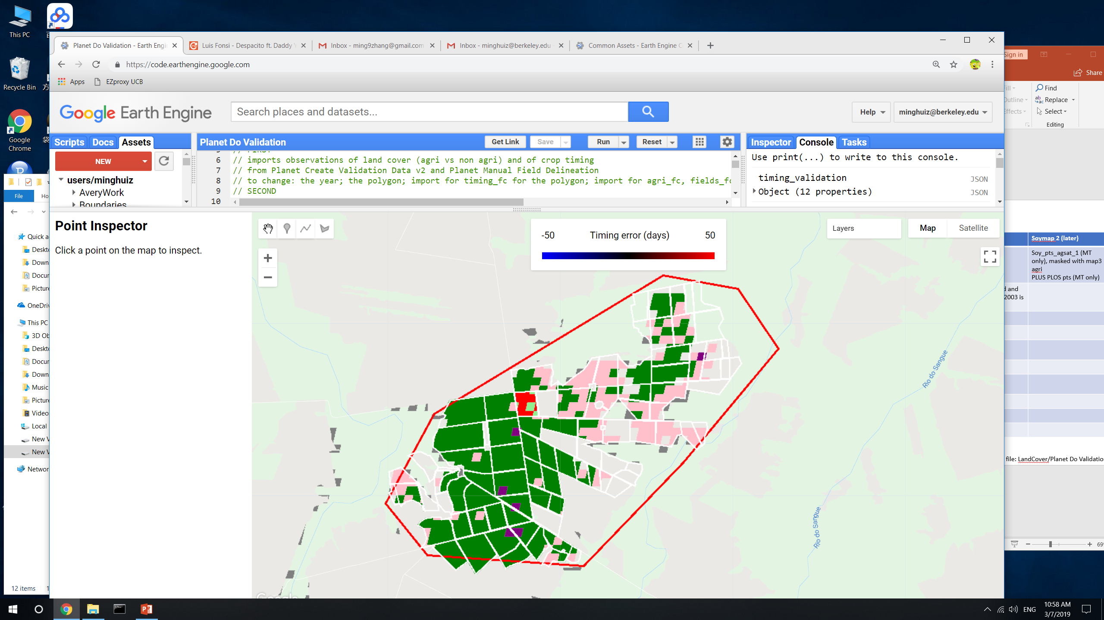
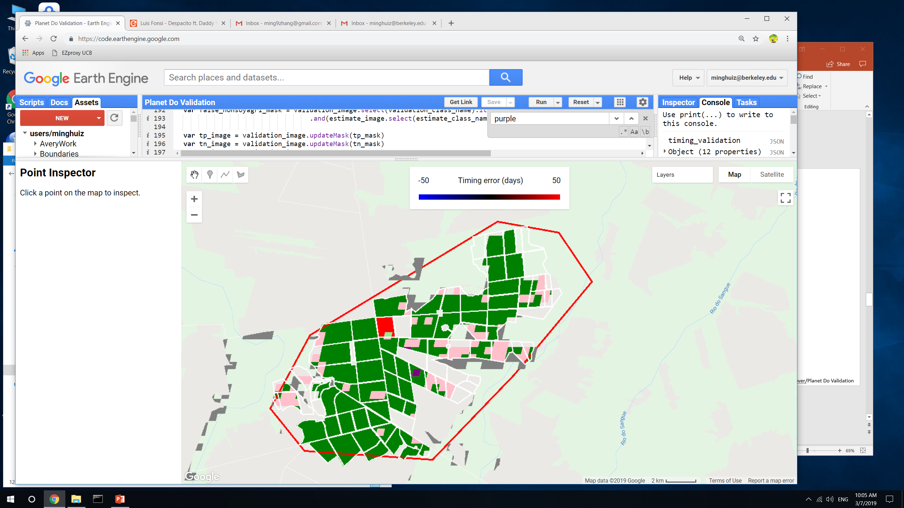
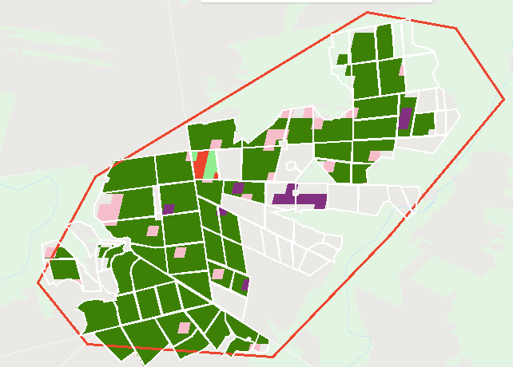
Land classification accuracy for poly5 (MT)
Legend:
True SC = light green
True DC = green
False SC = pink
False DC = red
False nonsoy agri = purple
False agri (actually natural) = gray
 |  | Jake’s soymap | Soymap 1 | Soymap 2
Poly5 (MT) | True SC | 0.01 | 0.005 | 0.015
 | True DC | 0.78 | 0.86 | 0.9
 | False SC | 0.18 | 0.11 | 0.07
 | False DC | 0.02 | 0.03 | 0.02
Jake’s soymap
Soymap 1
Soymap 2
GEE file: LandCover/Planet Do Validation v2

Slide 8
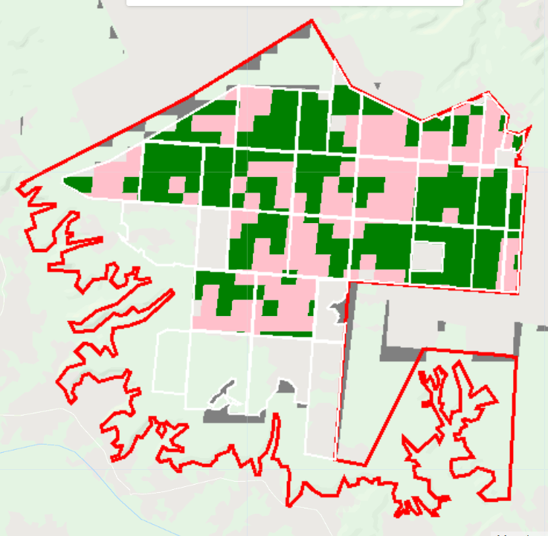
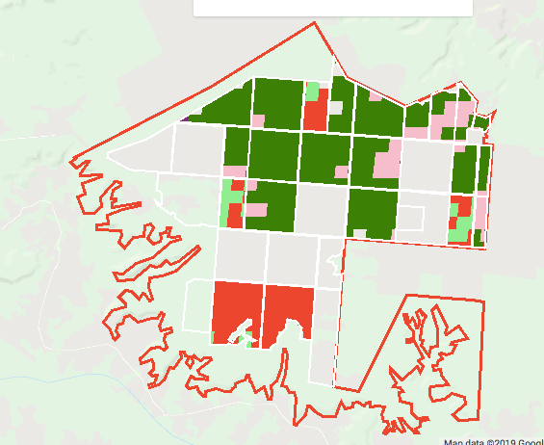
Land classification accuracy for poly1 (Piaui)
Legend:
True SC = light green
True DC = green
False SC = pink
False DC = red
False nonsoy agri = purple
False agri (actually natural) = gray
 |  | Jake’s soymap | Soymap 1 | Soymap 2 (later)
Poly1 (Piaui) | True SC | n/a | 0.12 | 0.07
 | True DC | n/a | 0.37 | 0.59
 | False SC | n/a | 0.33 | 0.10
 | False DC | n/a | 0.17 | 0.22
Soymap 1
Soymap 2
In soymap2, fields are more likely to be lumped in the same class, which is encouraging (soymap2 is more ‘stable’ within each field). This stability could be due to more training points or because Landsat introduced unnecessary and confusing timeseries information
GEE file: LandCover/Planet Do Validation v2

Slide 9
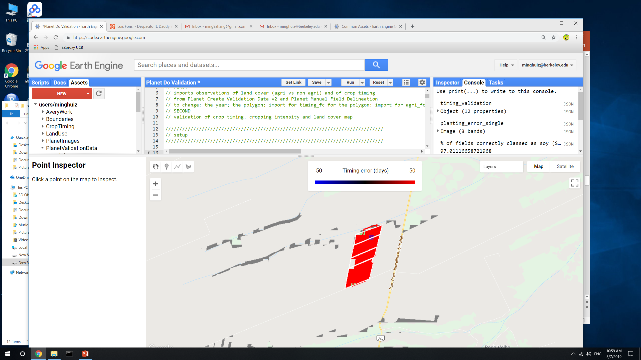
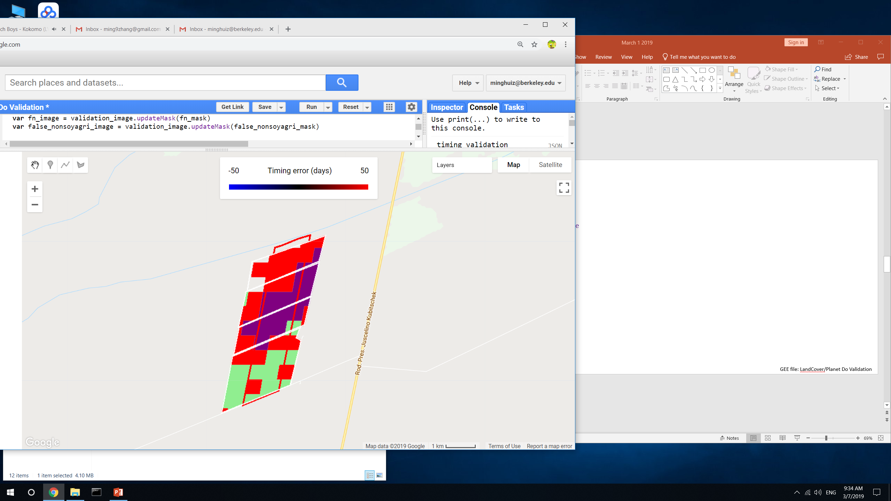
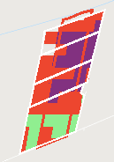
Land classification accuracy for poly3 (Bahia)
Legend:
True SC = light green
True DC = green
False SC = pink
False DC = red
False nonsoy agri = purple
False agri (actually natural) = gray
 |  | Jake’s soymap | Soymap 1 | Soymap 2 (later)
Poly3 (Bahia) | True SC | 0.03 | 0.38 | 0.27
 | True DC | 0 | 0 | 0
 | False SC | 0 | 0 | 0
 | False DC | 0.97 | 0.63 | 0.74
Jake’s soymap
Soymap 1
Soymap 2
GEE file: LandCover/Planet Do Validation v2

Slide 10
Spectral separation of Soy vs Nonsoy Agri
For agsat and PLOS training points, look at individual MODIS bands (which are used as input data for classification), aggregated over months, for each of the three classes (SC soy, DC soy, nonsoy agri)
Analysis was based on (Wilson et al, 2014)
Two ways to pick the dates over which to differentiate crops:
By days after planting
By data acquisition date (i.e. July 10, July 20, etc)
Found that late vegetative growth stage is optimal for crop separability (early vegetative stage: plants are too small and soil patches interfere)
Notes:
Mainly want to figure out how to separate nonsoy agri from the other two classes because can use timeseries analysis to separate SC from DC
MODIS band number | Wavelength (nm) | Name
1 | 620 - 670 | red
2 | 841 - 876 | nir
3 | 459 - 479 | blue
4 | 545 - 565 | green
5 | 1230 – 1250
6 | 1628 - 1652 | (not in the plots below)
7 | 2105 - 2155

Slide 11
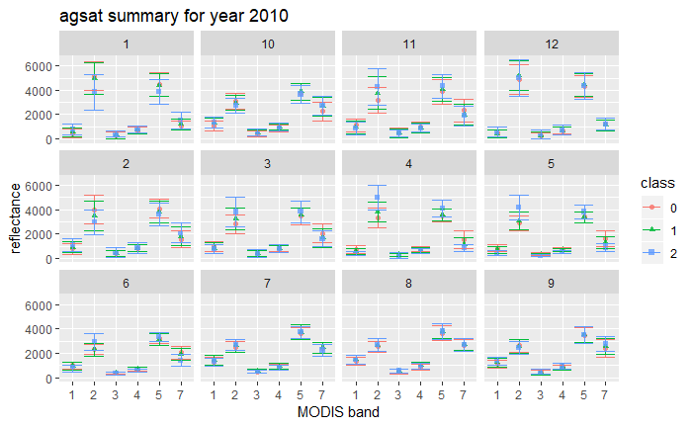
Panels = months
Class 2 = nonsoy agri
Class 0 and 1 = soy, SC and DC
R N B G
R file: Spectral_differentiation_v2.Rmd

Slide 12
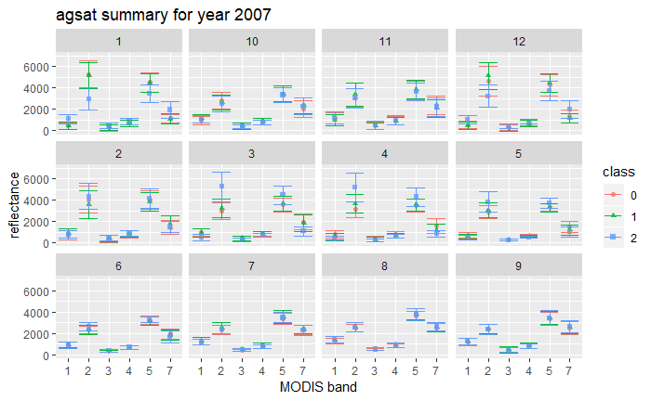
R file: Spectral_differentiation_v2.Rmd

Slide 13
Takeaways for spectral differentiation
Band 2 (NIR) is lower for class = 2 in Dec, Jan and Feb; it’s higher for class = 2 in March, April, May June
Band 5 is lower for class = 2 in Dec, Jan and Feb; it’s higher for class = 2 in March, Apr, May
There’s pretty much nothing in July, Aug, Sept, and Oct that can separate the three classes
Band 7 has larger scatter for class = 2 than for other cases, so band 7 is probably the least useful overall.
Band 1 (red) is higher for class = 2 in Dec and Jan; sometimes lower for class = 2 in July and Aug
For class = 2, there’s less vegetation (lower NIR, higher red) in Dec – Feb and more vegetation (higher NIR, lower red) in March – Aug

Slide 14
Temporal/phenological separation of Soy vs Nonsoy Agri
Temporal PCA on agsat and plos points for MODIS-derived EVI
‘variables’ are mean EVI in each 10-day chunk (i.e. 37 columns = 0 to 10 days, 11 to 20 days… after Jan 1)
‘rows/observations’ are the data points (i.e. spatial variability)
Examine what times of year have greatest contribution to spatial variability in EVI
EVI timeseries for each land cover class
2007 | Agsat | Plos
Class 0 (SC) | 15410 | 8567
Class 1 (DC) | 71581 | 10537
Class 2 (nonsoy agri) | 3636 | 9046
For interpreting results:
Agsat has more points, but Plos has more even distribution among classes
Plos lumps pasture into nonsoy agri, whereas agsat probably doesn’t

Slide 15
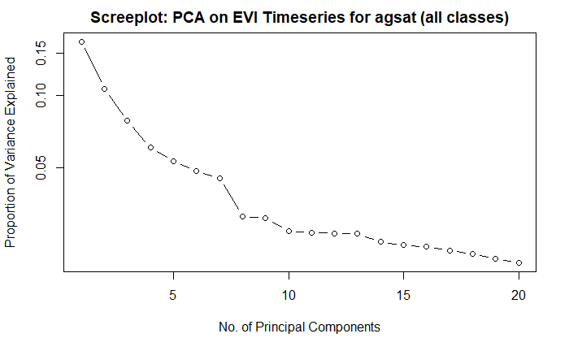
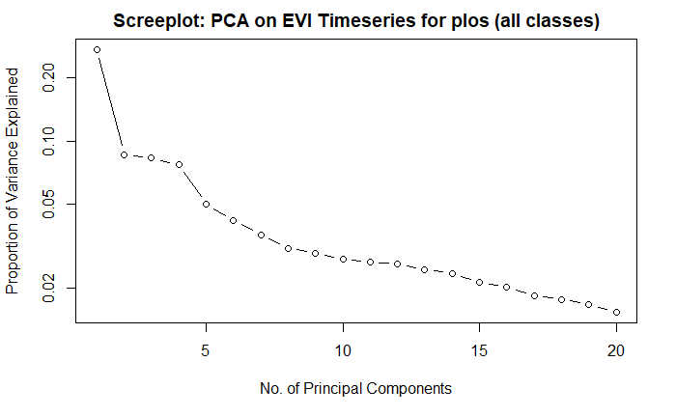
Spatial PCA on agsat and plos training data points in Mato Grosso
Year = 2007
The first several principal components don’t capture more than 50% of variation
In the loadings graphs below, positive correlation means the DOY contains a spatial pattern that has strong similarity to the pattern in the component image (i.e. that DOY reflects difference across space and therefore could be used in separating the classes?)
R file: Temporal_differentiation.Rmd

Slide 16
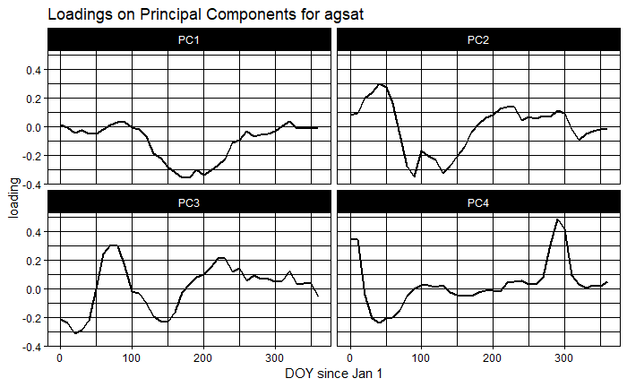
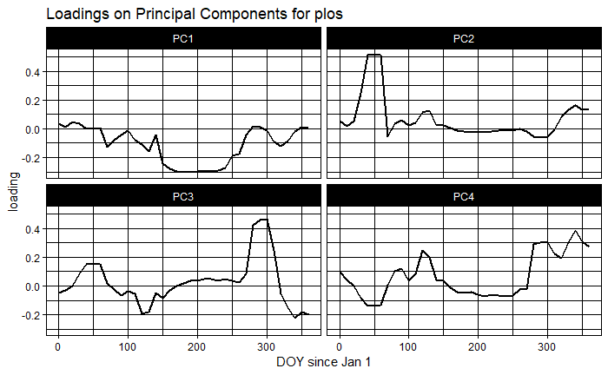
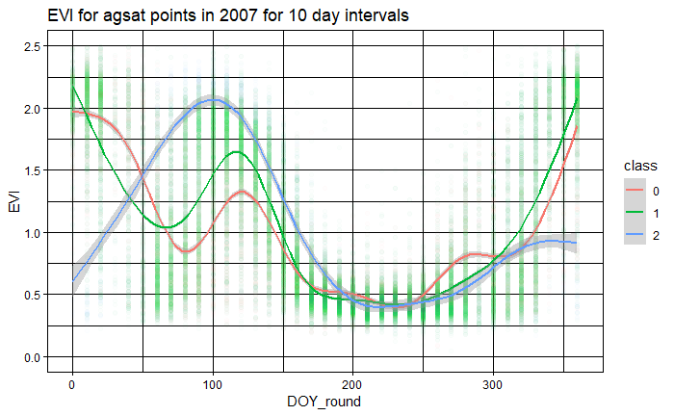
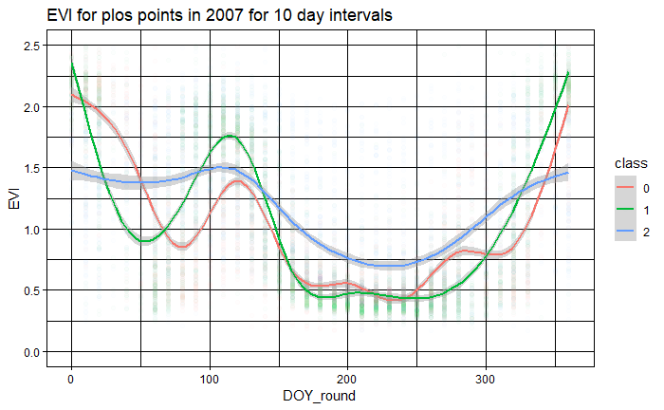
Spatial PCA on agsat and plos training data points in Mato Grosso
Year = 2007
R file: Temporal_differentiation_PCA.Rmd and Temporal_differentiation_timeseries.Rmd

Slide 17
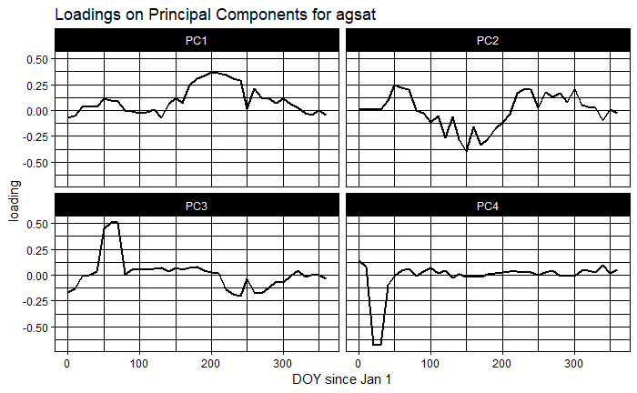
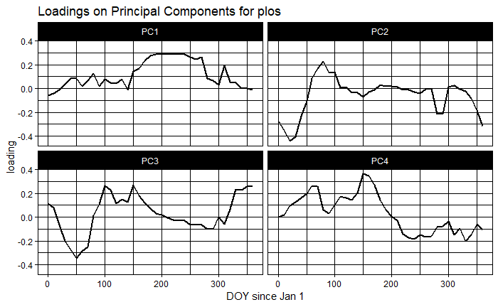
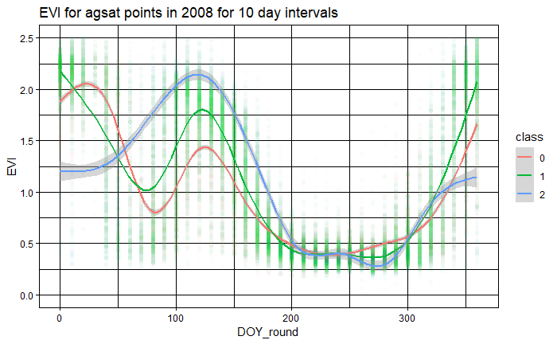
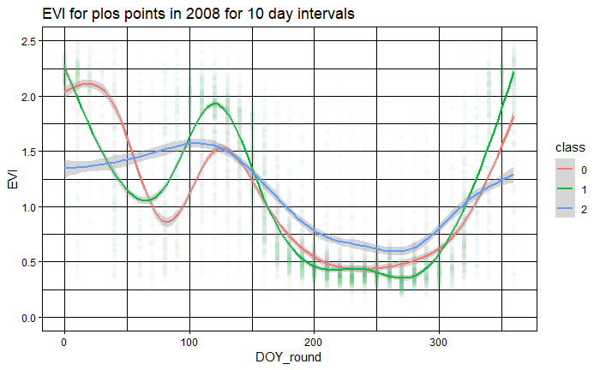
Spatial PCA on agsat and plos training data points in Mato Grosso
Year = 2008
R file: Temporal_differentiation_PCA.Rmd and Temporal_differentiation_timeseries.Rmd

Slide 18
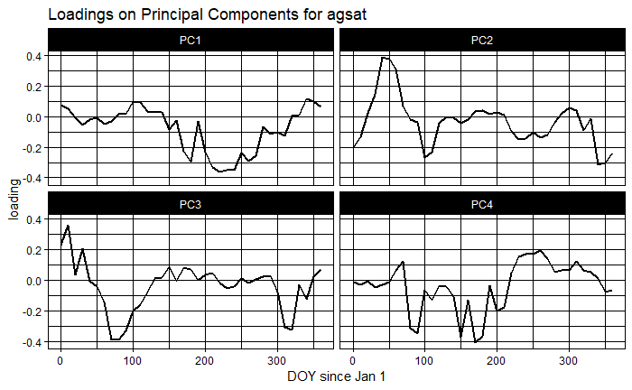
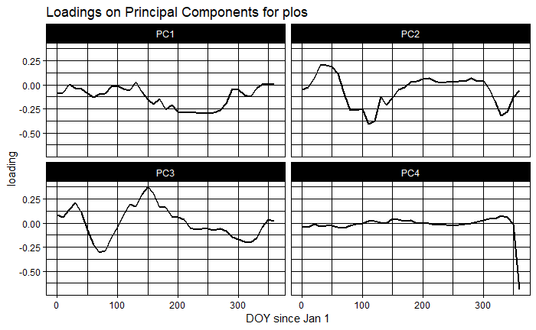
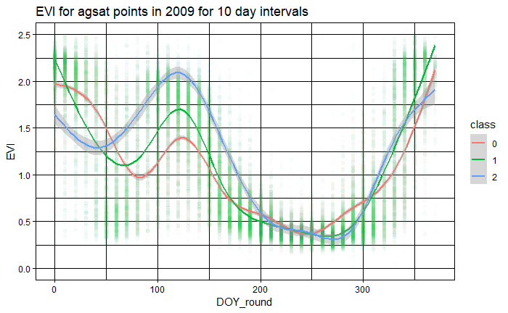
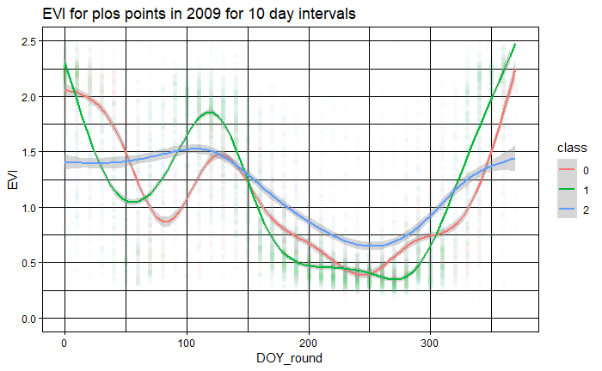
Spatial PCA on agsat and plos training data points in Mato Grosso
Year = 2009
R file: Temporal_differentiation_PCA.Rmd and Temporal_differentiation_timeseries.Rmd

Slide 19
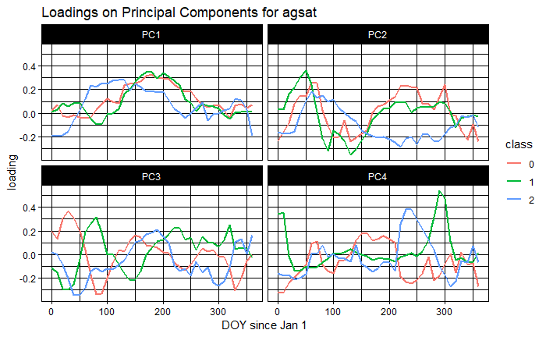
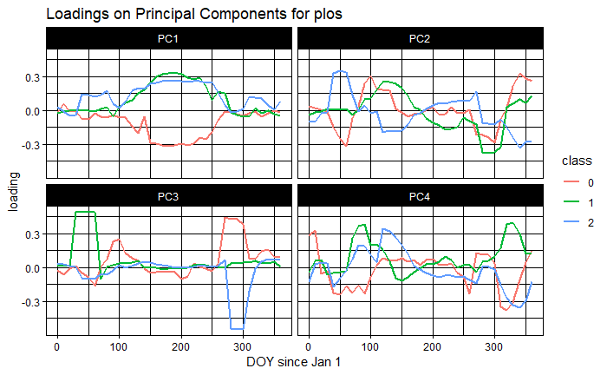
Spatial PCA on agsat and plos training data points in Mato Grosso
Year = 2007
It doesn’t make sense to do separate PCAs for each class, because all the within-class PCAs will show is how to separate WITHIN each class
The fact that the within-class PCAs have nonzero loadings suggests that there’s a lot of variation within each class?
R file: Temporal_differentiation.Rmd

Slide 20
Takeaways for phenological differentiation
From PCA
A PCA that lumps all classes together shows variation between the classes, but also variation within the classes.
Because plos has a more even distribution among the classes, it’s probably more reliable.
However, plos’s class = 2 contains pasture, which would be masked out with mapbiomas3 agri.
The variables DOY = 100 to 250 (April to August) tend to be more correlated with PC1. The variables DOY = 0 to 100 (January to March) tend to be more correlated with PC2.
PC1 seems to pick up on seasonal patterns; PC2 seems to pick up on the significant inter-class differences that happen between DOY = 0 and 150
Overall, can’t interpret much from PCA (ask Iryna?)
From timeseries
The first 150 days of the year (January to May) best separate the three classes
On average between DOY = 50 to 150, class = 2 has higher EVI than the other classes
On average between DOY = 0 to 50, class = 2 has lower EVI than the other classes
DOY 200 to 300 (July to October) don’t help separate the classes at all
PLOS contains pasture, so its class = 2 timeseries looks very different from the other two classes in the dry season (it’s much higher); however, in agsat, class = 2 looks very much like the other classes during the dry season
This analysis might help in picking the best time to separate classes, but doesn’t help in creating training data…

Slide 21
Based on spectral and phenological differences, target mid to late vegetative stage of first crop and the whole second crop; avoid dry season
Proposed input data for separating the three classes
From spectral differences (mid to late vegetative stage)
NIR from Dec to June
B5 from Dec to June
B1 from Dec to Jan
B1 from July to Aug
From observations of timing estimates
Days between peak1 and peak2
Quarter period of crop1 and crop2
Days after Aug 1 of peak1
From phenological differences (mid vegetative stage; usually the time fields transition from first to second crop)
EVI from January to March (NOT July to October)
Mato Grosso -> Matopiba
To apply classifier trained in Mato Grosso to Matopiba, doing data acquisition date alone won’t work because seasonality and planting dates are different
Option 1: get training data for Matopiba (soy vs nonsoy – how to get?)
Option 2: use classifier that was trained in Mato Grosso but adjust the data acquisition date
Shift data acquisition dates 1 - 2 months later based on lag in wet season onset in Matopiba compared to Mato Grosso
Come up with some way to figure out average mid-late vegetative stage of crops in Matopiba

Slide 22
Next
Ask Iryna about spectral and temporal separation of soy from nonsoy agri (purpose is to create training data in Matopiba)
Purchase Planet imagery + analyze
Create SC/DC training data in Matopiba with the help of Planet imagery; create soy vs nonsoy training data in Matopiba if possible
Soymap classification with the new input data from timing estimation, phenological + spectral differentiation results, new Matopiba training data if available
Center pivot

Slide 23
Validating timing with QA on validation data and timing estimates

Slide 24
GEE file: LandCover/Planet Add QA for Validation Data
Goes through poly1, poly3 and poly5 data to record whether my validation data have good accuracy/high confidence with the help of MODIS EVI timeseries. Also put in cropping intensity.
In the future, these should be done during initial Planet Create Validation Data script
Table:
Confidence = 0 means no confidence
Confidence = 1 means MODIS EVI timeseries and reported validation data seem to agree, or at most are 7 days apart
Confidence or cropping intensity = -1 means no data
Takeaways:
Noticed that the validation planting date range tends to be late; need to extend plant early to be even earlier (by about a week)
When it’s really clear when it harvested (i.e. short validation range), the harvest always happens right as the EVI gets to the baseline; harvest doesn’t happen before the baseline or point of max EVI decline
If there’s a sizeable (i.e. a month) bare soil gap between first and second crop, it’s easier to see p2 and h1; if they come very close together in time, they’re hard to separate in the MODIS timeseries (there’s just a gap of no data between h1 and p2), and it’s easy to get estimates wrong (and therefore will be masked out – source of bias?)
When there’s a short cycle ‘starter crop’ before the first crop, both the estimates and validation data get confused. Would mask these out and be biased against fields with starter crops in both validation process and in final map.

Slide 25
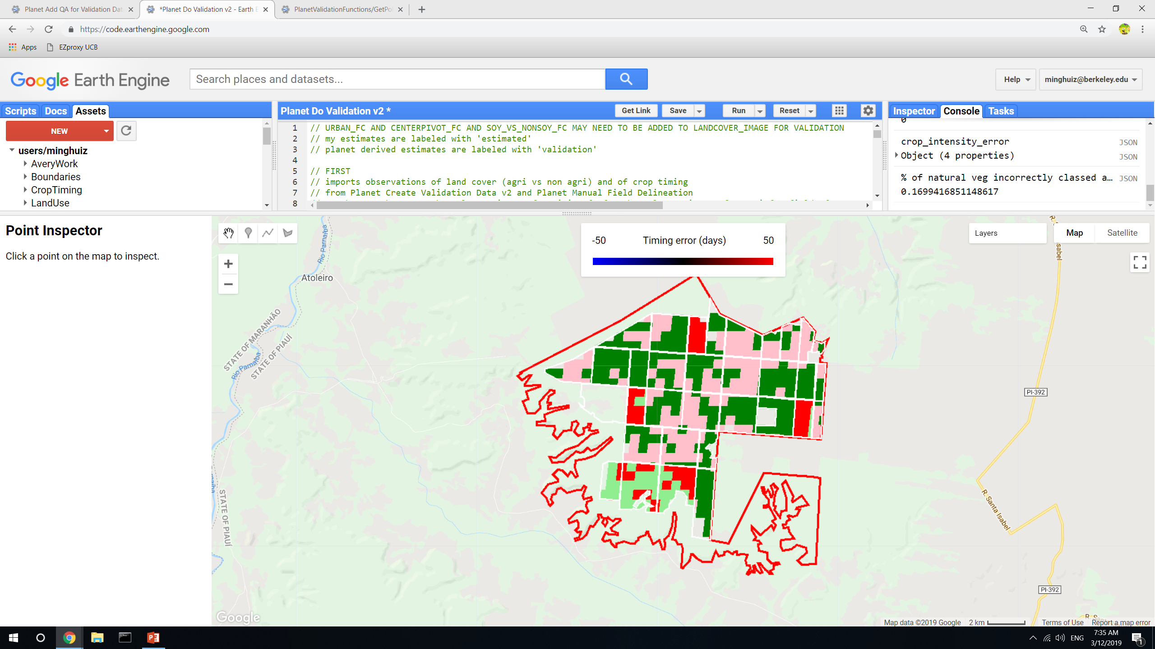
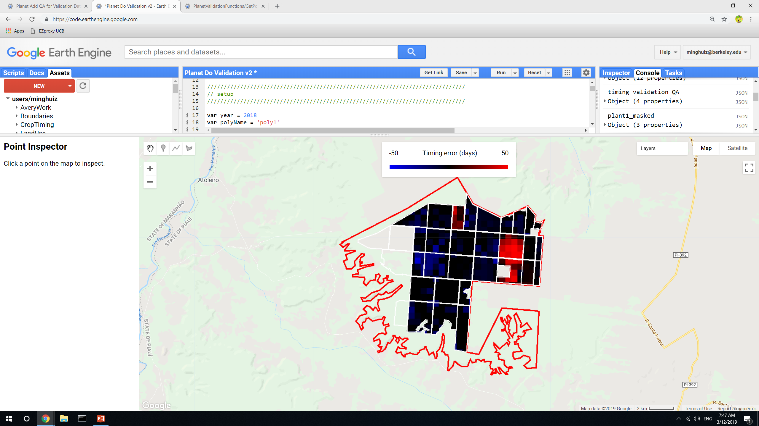
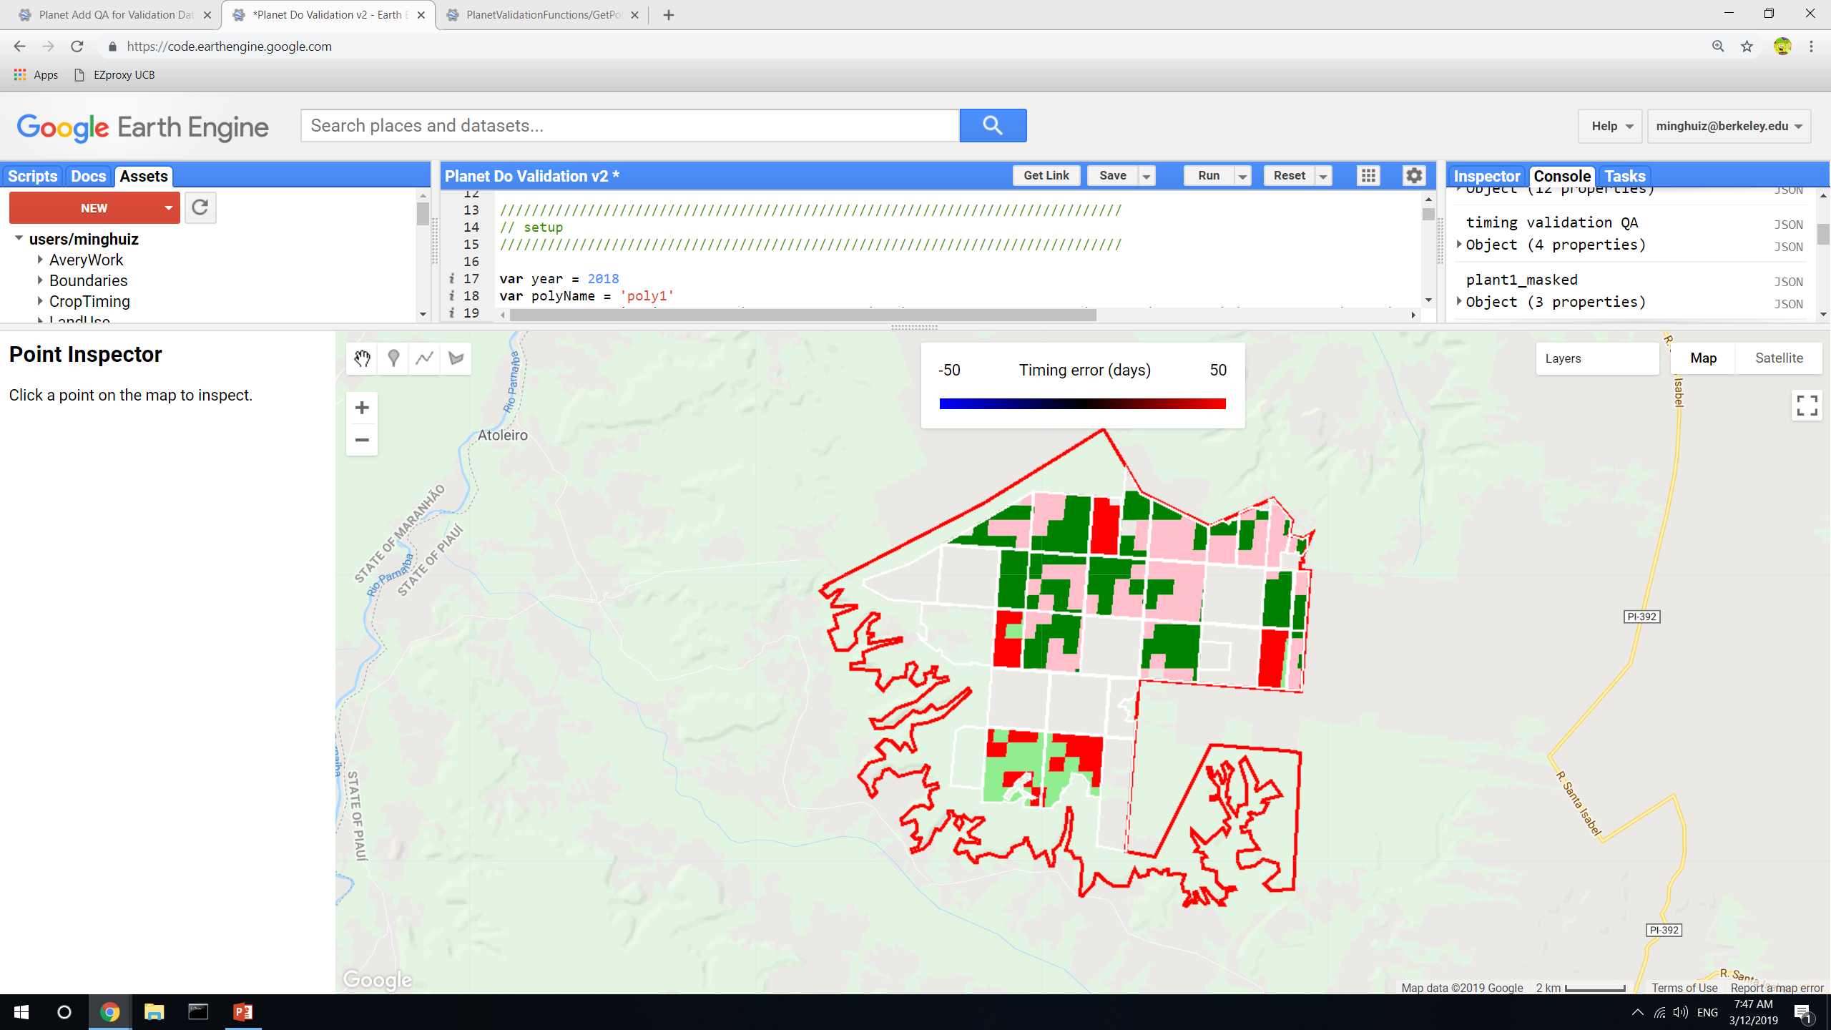
GEE file: LandCover/Planet Do Validation v2
Before doing validation, mask out validation data based on the ‘confidence’ generated in Planet Add QA for Validation Data (for poly 1, 3 and 5) or directly from Planet Create Validation Data v2
Also mask out ‘bad’ estimates that would be masked out anyway in the final map using peak timing and crop cycle
Crop cycle QA and timing QA are masked separately
Poly1, 2018 before QA masking
Poly1, 2018 after QA masking
Note, this is before the estimate pixels were masked; only entire fields were masked by validation confidence

Slide 26
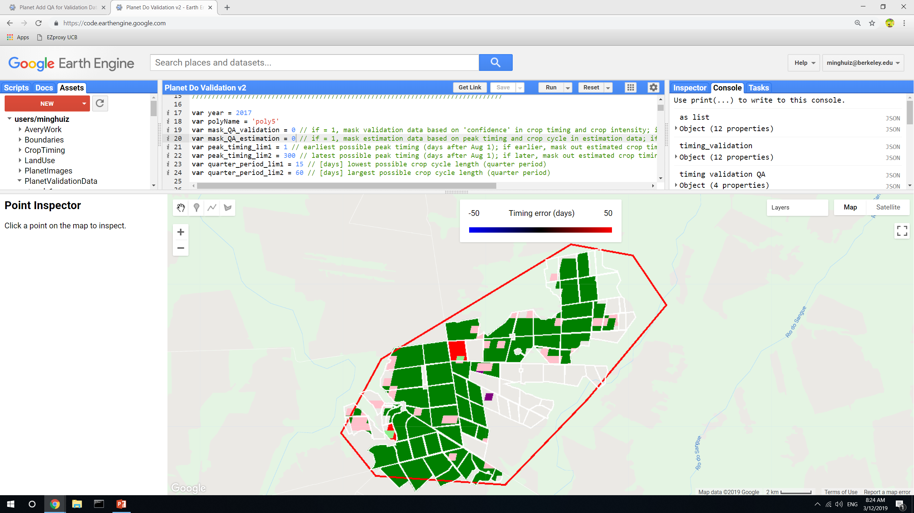
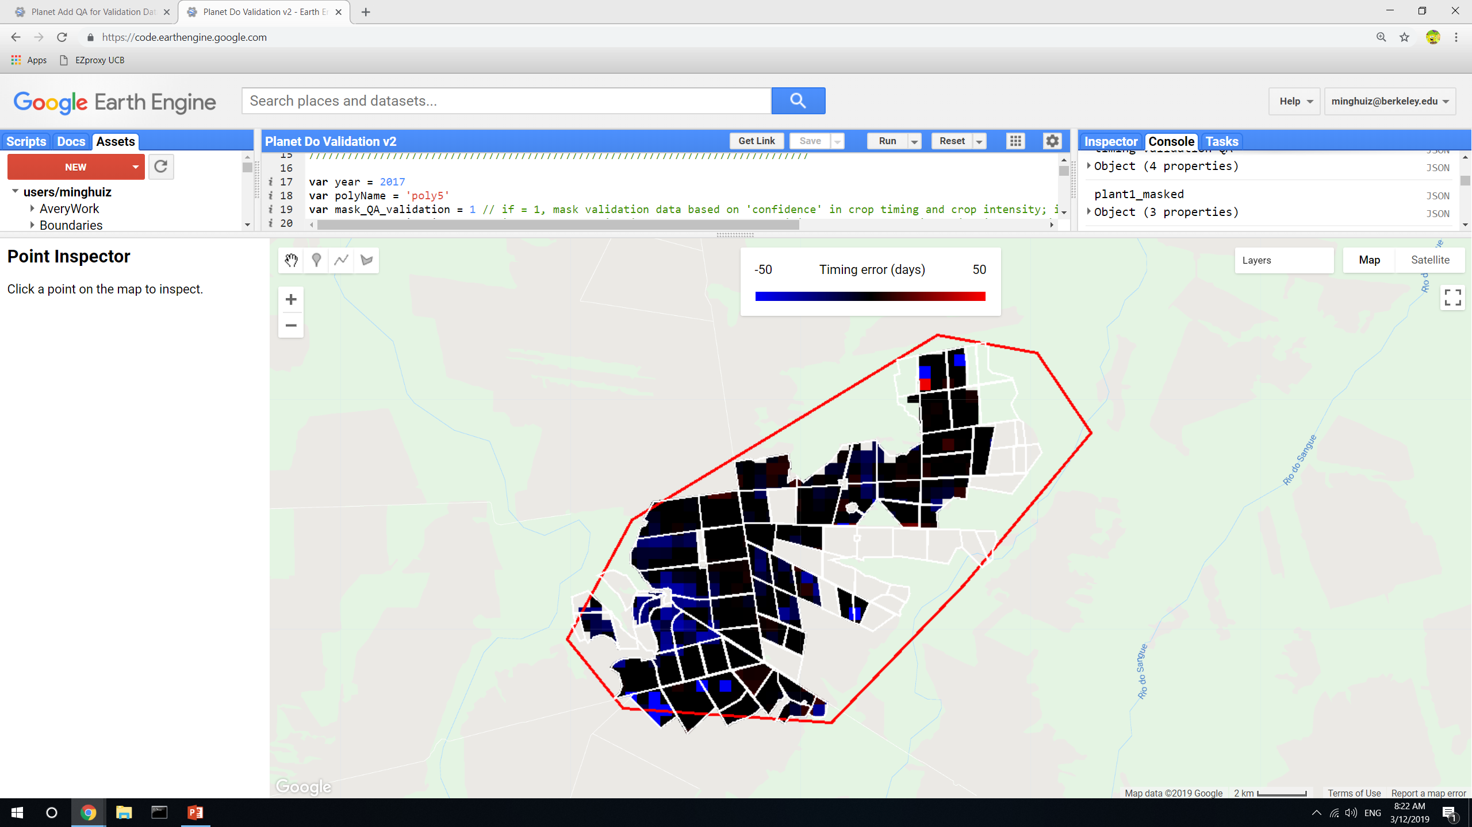
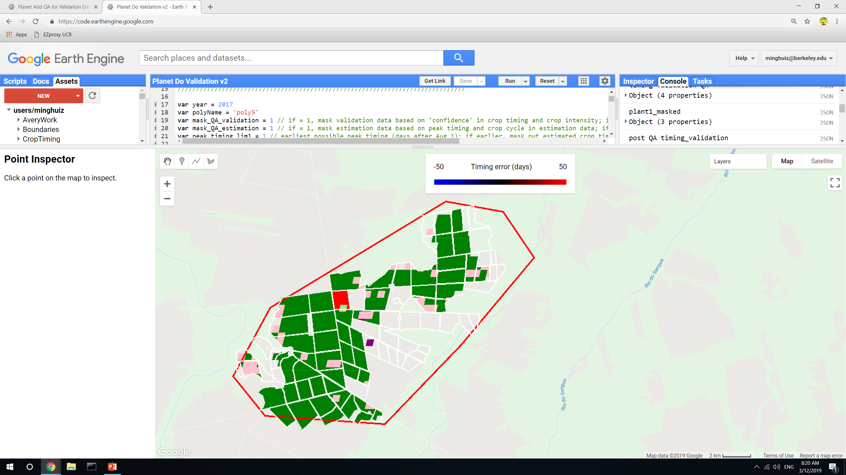
Poly5, 2017 before QA masking
Poly5, 2017 after QA masking
Note, this is before the estimate pixels were masked
GEE file: LandCover/Planet Do Validation v2

Slide 27
Poly5, 2017, plant 1 after QA masking (of both pixel level estimates and entire fields based on validation data confidence)
Unsure why estimated planting was totally off
Example of when estimate validated
GEE file: LandCover/Planet Do Validation v2

Slide 28
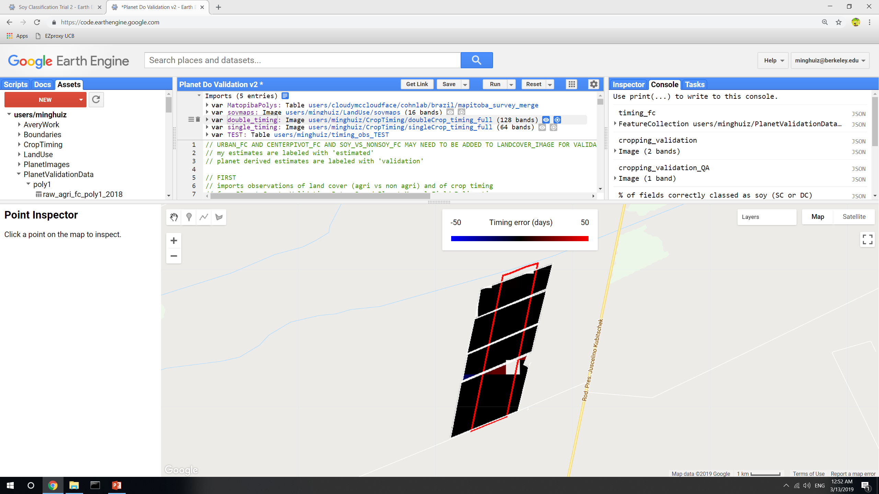
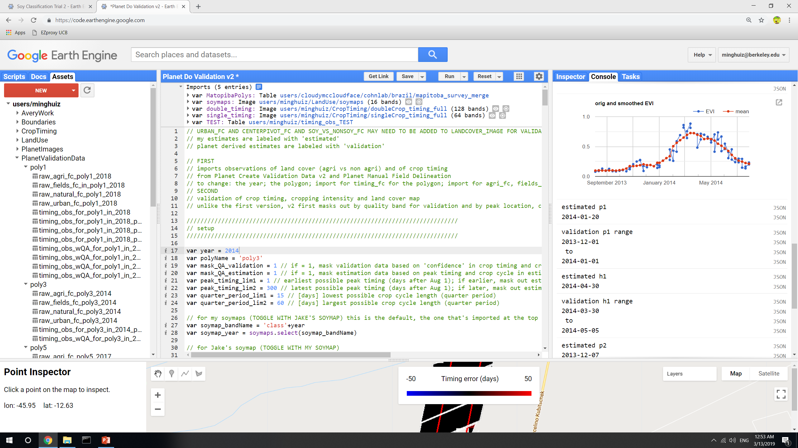
Poly3, 2014, plant 1 after QA masking (of both pixel level estimates and entire fields based on validation data confidence)
My planting estimate was 19 days too late
GEE file: LandCover/Planet Do Validation v2

Slide 29
Poly1, 2018, plant 1 after QA masking (of both pixel level estimates and entire fields based on validation data confidence)
Planting estimate mistook the second peak for the first peak
Planting estimate was probably better than validation data
GEE file: LandCover/Planet Do Validation v2

Slide 30
Planet imagery workflow
Uploading planet images as GEE asset
Properties of each image in PlanetLabs folder
Year, Month, Day, Satellite
PS_analytic_4band
RE_ortho_analytic
PS_ortho_analytic
PS_scene_analytic
Asset name is same as the description used in downloading from Planet web site
Lookup table in desktop has Planet order number and description and GEE asset name
Step | To do | Script/web site
1 | Find locations, years where Planet images are needed. Keep info on shp name, image name(s), and dates downloaded in Image_Lookup file in Google Drive | GEE: LandCover/Planet Image Selection
2 | Download cloud free, high temporal resolution Planet images (may need to pare down on locations, years) | Planet web site. Keep downloaded images in desktop
3 | Upload images as GEE assets | In desktop, keep tabs on asset id, polygon name, etc.
4 | Delineate individual fields, natural veg, agri, urban (houses) and center pivot in Planet imagery, and export as asset into the folder Planet Validation Data. The difference between fields and agri is that the fields contain individual (usu square) fields for timing observation purposes, whereas the agri contains lumped agri for land classification (natural vs agri) purposes. Assets are exported as ‘raw_agri_fc_poly1_year’, etc. need to turn delineated geometries into feature collections in order to export. | GEE: LandCover/Planet manual Field Delineation or Planet OBIA
5 | First import the Planet images and make custom visualizations for each, and map each with its own custom vis. Step through fields in CAR poly and record observed crop timing, export observations as feature collection to asset. Assets are exported as ‘timing_obs_for_polyName_in_year_part#’. Make sure to change the ‘part#’ BEFORE entering obs! 0 for SC, 1 for DC, 3 for TC or DC + failed first crop (2 is other agri in Jake’s classification) | GEE: Planet Create Validation Data v2
5.5 | (for poly1, poly3, and poly5), go back to the timing validation data exported from Planet Create Validation Data v2 and add ‘confidence level’ for my crop timing and crop intensity validation dataset; use MODIS TS to help replace previous crop intensity classification. For confidence labels, use -1 for no data (i.e. no second crop); 0 for no confidence; 1 for confident | GEE: Planet Add QA for Validation Data
6 | Import timing and land cover feature collections. May need to combine timing feature collections into a single fc. Turn feature collection of observations into validation image (might need to first merge multiple obs fcs into a single one), use to do validation. The following are turned into dictionaries of images (or simply images): the observed plant/harvest times; the observed cropping intensity; the observed land cover (agri - 10, center pivot - 20, natural - 30, urban – 40). Use images to do validation of timing and land cover maps. | GEE: Planet Do Validation

Slide 31
Validating land cover classification
(using additional training points beyond Jake’s method)

Slide 32
 | PLOS MT | Soy_pts_agsat_1
Description | Only in Mato Grosso (is the ‘new one’) | Only in Mato Grosso
GEE asset id | users/minghuiz/LandUse/MT_ground_reference_data_PLOS_2017 | users/cloudymccloudface/cohnlab/agroserv/soylc_train_pts_agsat_1
Years | 2005 – 2013 | 2003 - 2017
Property name | clsidYEAR (YEAR = 2005 to 2013) | class
soy-single | 2 | 0
Soy-double | 1 | 1
Agri, nonsoy | n/a | 2
Cotton | 3 | n/a (would be 2 in restructured PLOS)
Pasture/cerrado | 4 | n/a (would be 2 in restructured PLOS)
Soy-cotton | 9 | n/a (would be 2 in restructured PLOS)
Unknown value | 0 | n/a (would be -1, i.e. missing value, in restructured PLOS)
Reclassify PLOS MT to match soy_pts_agsat_1
Create a single training point for each year instead of lumping multiple years
Rules:
If old class of PLOS == 2, new class of PLOS == 0
If old class of PLOS == 1, new class of PLOS == 1
If old class of PLOS == 0, new class of PLOS == -1 (missing value)
If old class of PLOS is NOT 0, 1, or 2, new class of PLOS == 2
After restructuring PLOS, filter out class = -1 (missing value)
GEE file LandCover/Soy Classification Trial 2

Slide 33
 | Jake’s soymap | Soymap 1 | Soymap 2
GEE asset name | users/cloudymccloudface/cohnlab/agroserv/soy_sc_dc_agsat_mod_ls | Base_soymap_agsat_(year) for individual years soymap for image collection of all years | Base_soymap_agsat_PLOS_(year) for individual years Soymap_2 for image collection of all years
Training points | Soy_pts_agsat_1 (MT only) | Soy_pts_agsat_1 (MT only), masked with map3 agri | Soy_pts_agsat_1 (MT only), masked with map3 agri PLUS PLOS pts (MT only)
Year pooling | Each year has separate trained classifier | 2004-2017 points are pooled and are applied to 2004 – 2018; 2003 is trained and applied by itself | 2004-2017 points are pooled and are applied to 2004 – 2018; 2003 doesn’t have data yet
Input data | MODIS, Landsat | Same as Jake’s soymap | Same as Jake’s soymap MINUS Landsat bands
Naming convention for soymaps:
“base” means just masked by mapbiomas3, no connectionMask
“agsat” and “PLOS” mean the training data source
Unless otherwise specified, all years’ training data are pooled to train a single classifier
My soymaps are first exported separately for individual years; then use GEE file LandCover/Soy Classification Create Final Asset to make image collection
GEE file LandCover/Soy Classification Trial 1, Soy Classification Trial 2

Slide 34
Soy Classification Trial 2 v2
2011 and 2012 PLOS training points: including these in the sample creates a Error in map() Number.short: Parameter ‘input’ is required error. This probably happens during sample_infill() function which, for properties with a null value, it replaces that value with the average over the other features for that property. This generates and error when all the points are null – so there’s nothing to take average of.
Another issue after doing sample_infill() for all years: seems like one point doesn’t have ‘ls_B0_1’ band, so try to filter out sample_data_all based on whether feature has maximum number of properties. This gave “Error: Image.classify: No data was found in classifier training input”
The above ‘fix’ still gave an error, so tried to get rid of all landsat information as input, except for terrain variables. It seems some years are missing landsat bands.
Produces base_soymap_agsat_PLOS_year maps

Slide 35
Land classification accuracy for poly5 (MT)
Legend:
True SC = light green
True DC = green
False SC = pink
False DC = red
False nonsoy agri = purple
False agri (actually natural) = gray
All fields except one (the red one) are DC or TC
This region has a lot of soy training points (it was chosen for its soy training point density)
Soymap 1
Soymap 2
Jake’s soymap
GEE file: LandCover/Planet Do Validation v2

Slide 36
Land classification accuracy for poly3 (Bahia)
Legend:
True SC = light green
True DC = green
False SC = pink
False DC = red
False nonsoy agri = purple
False agri (actually natural) = gray
All fields are SC
This region has no soy training points
Soymap 1
Soymap 2
Jake’s soymap
GEE file: LandCover/Planet Do Validation v2

Slide 37
Land classification accuracy for poly1 (Piaui)
Legend:
True SC = light green
True DC = green
False SC = pink
False DC = red
False nonsoy agri = purple
False agri (actually natural) = gray
All fields are DC
This region doesn’t contain soy training points
In soymap2, fields are more likely to be lumped in the same class, which is encouraging (soymap2 is more ‘stable’ within each field). This stability could be due to more training points or because Landsat introduced unnecessary and confusing timeseries information
Soymap 1
Soymap 2
Jake’s soymap
(Jake’s soymap doesn’t have 2018)
GEE file: LandCover/Planet Do Validation v2

Slide 38
SC vs DC accuracy: normalized by area of SC + DC in validation data
Conclusion: it’s better for SC vs DC accuracy to pool years and use more data points, even where there isn’t training data
 |  | Jake’s soymap | Soymap 1 | Soymap 2 (later)
Training points |  | Soy_pts_agsat_1 (MT only) | Soy_pts_agsat_1 (MT only), masked with map3 agri | Soy_pts_agsat_1 (MT only), masked with map3 agri PLUS PLOS pts (MT only)
Year pooling |  | Each year has separate trained classifier | 2004-2017 points are pooled and are applied to 2004 – 2018; 2003 is trained and applied by itself | 2004-2017 points are pooled and are applied to 2004 – 2018; 2003 doesn’t have data yet
Input data |  | MODIS, Landsat | Same as Jake’s soymap | Same as Jake’s soymap MINUS Landsat bands
Post classification masking |  | Map2.3 | Map3 | map3
Poly1 (Piaui) | True SC | n/a | 0.12 | 0.07
 | True DC | n/a | 0.37 | 0.59
 | False SC | n/a | 0.33 | 0.10
 | False DC | n/a | 0.17 | 0.22
Poly3 (Bahia) | True SC | 0.03 | 0.38 | 0.27
 | True DC | 0 | 0 | 0
 | False SC | 0 | 0 | 0
 | False DC | 0.97 | 0.63 | 0.74
Poly5 (MT) | True SC | 0.01 | 0.005 | 0.015
 | True DC | 0.78 | 0.86 | 0.9
 | False SC | 0.18 | 0.11 | 0.07
 | False DC | 0.02 | 0.03 | 0.02
GEE file: LandCover/Planet Do Validation

Slide 39
Soy vs nonsoy agri accuracy
NOTE: assumed that all fields are soy; tested whether land use map classifies all fields as soy
Takeaway: made a big assumption, so it’s unclear which soy map is better
 |  | Jake’s soymap | Soymap 1 | Soymap 2 (later)
Training points |  | Soy_pts_agsat_1 (MT only) | Soy_pts_agsat_1 (MT only), masked with map3 agri | Soy_pts_agsat_1 (MT only), masked with map3 agri PLUS PLOS pts (MT only)
Year pooling |  | Each year has separate trained classifier | 2004-2017 points are pooled and are applied to 2004 – 2018; 2003 is trained and applied by itself | 2004-2017 points are pooled and are applied to 2004 – 2018; 2003 doesn’t have data yet
Input data |  | MODIS, Landsat | Same as Jake’s soymap | Same as Jake’s soymap MINUS Landsat bands
Post classification masking |  | Map2.3 | Map3 | map3
Poly1 (Piaui) | % fields correctly classed as soy | n/a | 95 | 95
 | % fields incorrectly classed as nonsoy agri | n/a | 0 | 0
Poly3 (Bahia) | % fields correctly classed as soy | 97 | 62 | 61
 | % fields incorrectly classed as nonsoy agri | 3 | 35 | 35
Poly5 (MT) | % fields correctly classed as soy | 84 | 92 | 91
 | % fields incorrectly classed as nonsoy agri | 1.3 | 0.45 | 2.7
GEE file: LandCover/Planet Do Validation

Slide 40
Agri vs natural accuracy
Takeaway: unclear which soymap is better, but agri vs natural veg accuracy isn’t a huge concern
 |  | Jake’s soymap | Soymap 1 | Soymap 2 (later)
Training points |  | Soy_pts_agsat_1 (MT only) | Soy_pts_agsat_1 (MT only), masked with map3 agri | Soy_pts_agsat_1 (MT only), masked with map3 agri PLUS PLOS pts (MT only)
Year pooling |  | Each year has separate trained classifier | 2004-2017 points are pooled and are applied to 2004 – 2018; 2003 is trained and applied by itself | 2004-2017 points are pooled and are applied to 2004 – 2018; 2003 doesn’t have data yet
Input data |  | MODIS, Landsat | Same as Jake’s soymap | Same as Jake’s soymap MINUS Landsat bands
Post classification masking |  | Map2.3 | Map3 | map3
Poly1 (Piaui) | (area natural veg classed as agri)/(total area area)*100 | n/a | 0.16 | 0.17
Poly3 (Bahia) | (area natural veg classed as agri)/(total area area)*100 | 0.2 | 0.4 | 0.43
Poly5 (MT) | (area natural veg classed as agri)/(total area area)*100 | 3.7 | 6.3 | 6.3
This is basically a measure of map2.3 vs map3 agriculture class accuracy
GEE file: LandCover/Planet Do Validation

Slide 41
Spectral separation of Soy vs Nonsoy Agri

Slide 42
Separating soy vs nonsoy agriculture
Use MT_PLOS_pts and soy_pts_agsat_1
In GEE file Landcover/Soy vs Nonsoy Agri Differentiation, produce tables with surface reflectance of 8 day MODIS composite images (masked for clouds) along with reported land cover classification for 2003 to 2017. Export as table to Drive, one for MT_PLOS_pts and one for soy_pts_agsat_1
Use R code to look at how soy and nonsoy could be spectrally separated with MODIS
MODIS band number | Wavelength (nm) | Name
1 | 620 - 670 | red
2 | 841 - 876 | nir
3 | 459 - 479 | blue
4 | 545 - 565 | green
5 | 1230 – 1250
6 | 1628 - 1652 | (not in the plots below)
7 | 2105 - 2155
GEE file: LandCover/Soy vs Nonsoy Agri Differentiation

Slide 43
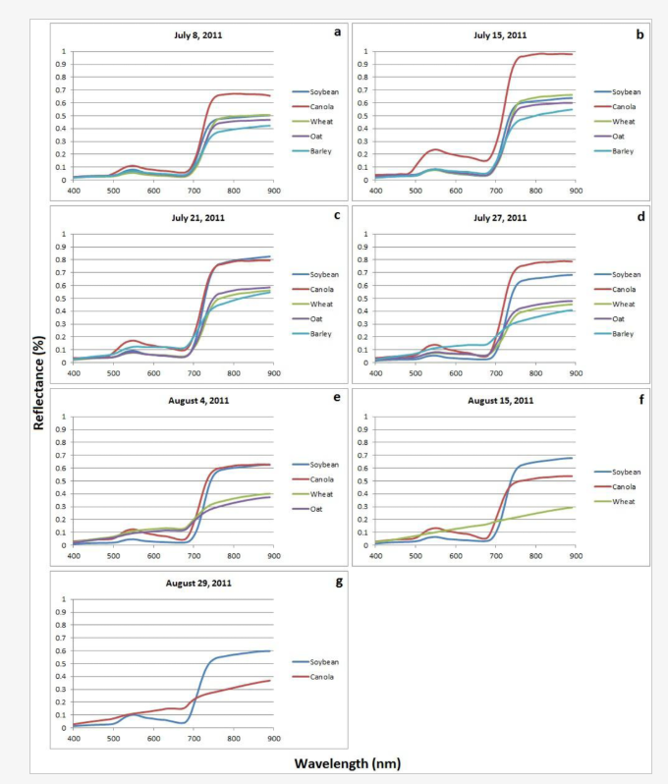
Differentiating soy from other crops (canola, wheat, oat, barley) using hyperspectral bands in Canada (Wilson et al, 2014) in Remote Sensing
Because they had hyperspectral data, they used discriminant function analysis to reduce dimensionality
Two ways to pick the dates over which to differentiate crops:
By days after planting
By data acquisition date (i.e. July 10, July 20, etc)
See plots
Found that late vegetative growth stage is optimal for crop separability (early vegetative stage: plants are too small and soil patches interfere)
For Mato Grosso vs Matopiba, doing data acquisition date alone won’t work because planting dates are totally different
Using days after planting may work but need to consider double and triple cropping
Temporal principle component analysis might help highlight the most common timing scenarios that would help in choosing whether to use days after planting or data acquisition date in getting input data

Slide 44
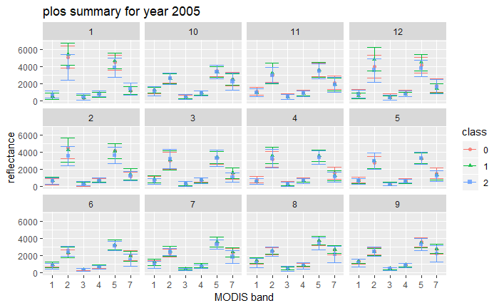
R file: Spectral_differentiation_v2.Rmd

Slide 45
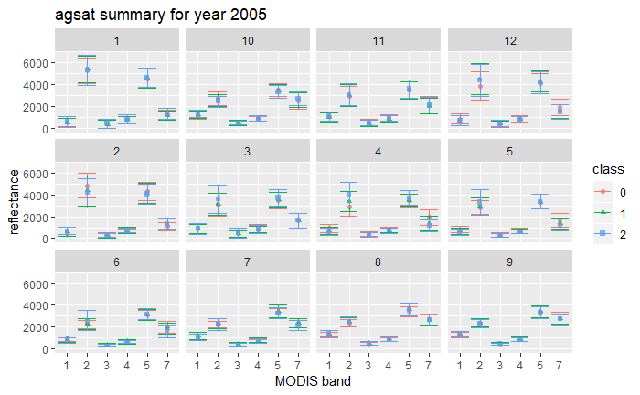
R file: Spectral_differentiation_v2.Rmd

Slide 46
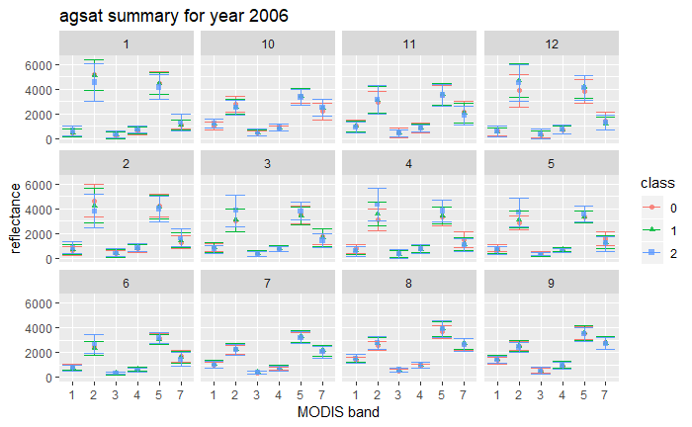
R file: Spectral_differentiation_v2.Rmd

Slide 47
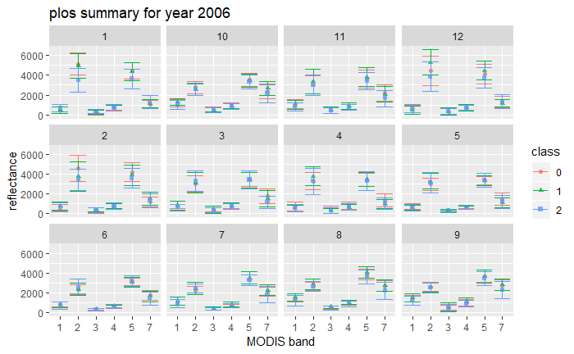
R file: Spectral_differentiation_v2.Rmd

Slide 48
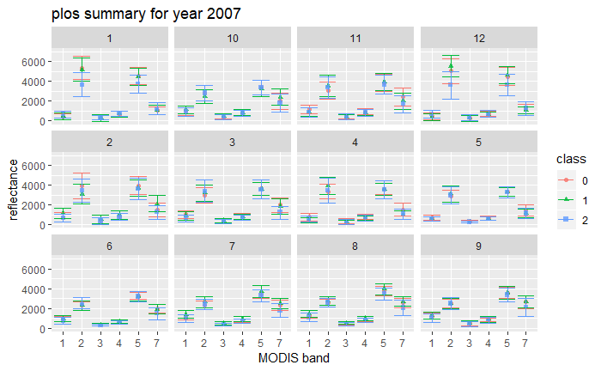

Slide 50


Slide 51


Slide 52


Slide 53


Slide 54
Panels = months
Class 2 = nonsoy agri
Class 0 and 1 = soy, SC and DC
R N B G
R file: Spectral_differentiation_v2.Rmd

Slide 55

R file: Spectral_differentiation_v2.Rmd

Slide 56

R file: Spectral_differentiation_v2.Rmd

Slide 57

Zoomed in picture to see bands 1, 3, 4, 7
R file: Spectral_differentiation_v2.Rmd

Slide 58

Zoomed in picture to see bands 1, 3, 4, 7
R file: Spectral_differentiation_v2.Rmd

Slide 59

Zoomed in picture to see bands 1, 3, 4, 7
R file: Spectral_differentiation_v2.Rmd

Slide 60

Zoomed in picture to see bands 1, 3, 4, 7
R file: Spectral_differentiation_v2.Rmd

Slide 61

Zoomed in picture to see bands 1, 3, 4, 7
R file: Spectral_differentiation_v2.Rmd

Slide 62

Zoomed in picture to see bands 1, 3, 4, 7
R file: Spectral_differentiation_v2.Rmd

Slide 63

Zoomed in picture to see bands 1, 3, 4, 7
R file: Spectral_differentiation_v2.Rmd

Slide 64

Zoomed in picture to see bands 1, 3, 4, 7
R file: Spectral_differentiation_v2.Rmd

Slide 65

Zoomed in picture to see bands 1, 3, 4, 7
R file: Spectral_differentiation_v2.Rmd

Slide 66

R file: Spectral_differentiation_v2.Rmd

Slide 67

Zoomed in picture to see bands 1, 3, 4, 7
R file: Spectral_differentiation_v2.Rmd

Slide 68

Zoomed in picture to see bands 1, 3, 4, 7
R file: Spectral_differentiation_v2.Rmd

Slide 69

Using NIR, red, blue and green bands to calculate multiband indices: none of them look able to separate soy from nonsoy agri
R file: Spectral_differentiation_v2.Rmd

Slide 70

R file: Spectral_differentiation_v2.Rmd

Slide 71
Takeaway for spectral differentiation
Can use timeseries analysis to separate class = 0 from class = 1; mainly want to figure out how to separate class = 2 from the other two
Band 2 (NIR) is lower for class = 2 in Dec, Jan and Feb; it’s higher for class = 2 in March, April, May June
Band 5 is lower for class = 2 in Dec, Jan and Feb; it’s higher for class = 2 in March, Apr, May
There’s pretty much nothing in July, Aug, Sept, and Oct that can separate the three classes
Band 7 has larger scatter for class = 2 than for other cases, so band 7 is probably the least useful overall. Sometimes class = 2 is lower, but with very high variation it’s hard to tell if it’s a consistent pattern across the years
Band 1 (red) is higher for class = 2 in Dec and Jan; sometimes lower for class = 2 in July and Aug
R file: Spectral_differentiation_v2.Rmd

Slide 72
Temporal/phenological separation of Soy vs Nonsoy Agri

Slide 73


Background information for temporal/spatial PCA:
Source: http://karthur.org/2017/learning-for-time-series-ssa-vs-pca.html
Spatial PCA
Data must be in wide format, i.e. the time spans the columns. [X]ij= location is (i) and time is (j)
See code in the link above to do PCA on the wide format code
Plot the right singular vectors (see code) to get loadings of each variable on each of the principal components. Since the ‘variables’ in the timeseries data are just different days/years/units of time, what the loadings represent is the contribution of each time to the spatial pattern of variance. (I can break data into SC, DC and nonsoy agri and apply spatial PCA on each of these subsets to see what determines the spatial patterns of each class; can also subset by Matopiba, Mato Grosso regions). In this example, the fact that PC1 is constant over time means that the dominant variation in the data occurs over space.
Map the principal component (PC) scores (i.e. original values projected onto the principle components). The code does this in terms of number of standard deviations around the mean score. Areas with positive correlations in the map follow the time trend indicated in the loadings for that principal component. Here, PC1 just indicates the dominant time invariant spatial variation.

Slide 74

Background information for temporal/spatial PCA:
Source: http://karthur.org/2017/learning-for-time-series-ssa-vs-pca.html
SSA (singular spectrum analysis) = temporal PCA
The purpose of SSA is to discover oscillation series of any length within a longer timeseries. Unlike PCA, SSA is performed on a univariate dataset
PCA (spatial PCA) takes one variable observed at multiple locations
SSA takes one var observed over time at a single location
Interpreting SSA is hard – its used for smoothing, achieved in the reconstruction of the original signal using a subset of the components.
However, SSA seems to break the timeseries down into its patterns; it doesn’t seem to summarize time trajectories over space (we need a spatial + temporal PCA)?

Slide 75
Spatial PCA on agsat and plos training data points in Mato Grosso
Data manipulation
For agsat and plos points that are exported from Soy vs Nonsoy Agri Differentiation, calculate EVI
Turn the daily DOY variable into ‘rounded DOY’ to the closest ten day mark (i.e. DOY 293 becomes DOY_round = 290) so there’s less missing data and fewer variables (i.e. fewer DOYs)
Turn data into wide format, where each level of DOY_round is a column. Because some points have multiple EVI values in the same level of DOY_round, group by point_id and DOY_round and take the mean EVI.
Missing data imputation
Before doing PCA, need to handle missing values – do linear interpolation to fill them in
The PCA is done on EVI
PCA
Look at screeplot and variable loadings on the four major principal components for:
Agsat and plos points
All classes lumped, and each of the three classes separately
2007 | Agsat | Plos
Class 0 | 15410 | 8567
Class 1 | 71581 | 10537
Class 2 | 3636 | 9046
For interpreting results of PCA: Agsat has more points, but Plos has more even distribution among classes
R file: Temporal_differentiation.Rmd

Slide 76
Spatial PCA on agsat and plos training data points in Mato Grosso
Year = 2007
The first several principal components don’t capture more than 50% of variation
R file: Temporal_differentiation.Rmd

Slide 77




Spatial PCA on agsat and plos training data points in Mato Grosso
Year = 2005
R file: Temporal_differentiation_PCA.Rmd and Temporal_differentiation_timeseries.Rmd

Slide 78




Spatial PCA on agsat and plos training data points in Mato Grosso
Year = 2006
R file: Temporal_differentiation.Rmd

Slide 79
Spatial PCA on agsat and plos training data points in Mato Grosso
Year = 2007
R file: Temporal_differentiation.Rmd

Slide 80
Spatial PCA on agsat and plos training data points in Mato Grosso
Year = 2008
R file: Temporal_differentiation.Rmd

Slide 81
Spatial PCA on agsat and plos training data points in Mato Grosso
Year = 2009
R file: Temporal_differentiation.Rmd

Slide 82




Spatial PCA on agsat and plos training data points in Mato Grosso
Year = 2011
R file: Temporal_differentiation.Rmd

Slide 83




Spatial PCA on agsat and plos training data points in Mato Grosso
Year = 2012
R file: Temporal_differentiation.Rmd

Slide 84




Spatial PCA on agsat and plos training data points in Mato Grosso
Year = 2013
R file: Temporal_differentiation.Rmd

Slide 85


Spatial PCA on agsat and plos training data points in Mato Grosso
Year = 2005
Positive correlation means the DOY contains a latent spatial pattern that has strong similarity to the pattern in the component image (i.e. that DOY reflects difference across space).
PC1 seems to capture some kind of seasonality but not sure why the correlations are sometimes positive and sometimes negative
The fact that for the same year, agsat and plos have different graphs indicates there’s an issue with stability in the result
It doesn’t make sense to separate classes when doing PCA, because all the within-class PCAs will show is how to separate WITHN each class
R file: Temporal_differentiation.Rmd

Slide 86
Spatial PCA on agsat and plos training data points in Mato Grosso
Year = 2007
What DOYs generally correspond to the largest difference between class = 2 and the other two classes across the years in PC1? Sometimes class = 2 is inseparable from the other class the whole year; sometimes it’s separable the whole year; sometimes (DOY = 60 to 100) gives the most separation.
Note that in PLOS, a lot of different land covers are lumped into class = 2. what if we break apart class = 2 into the original classes from PLOS dataset?
R file: Temporal_differentiation.Rmd

Slide 87


Spatial PCA on agsat and plos training data points in Mato Grosso
Year = 2008
R file: Temporal_differentiation.Rmd

Slide 88


Spatial PCA on agsat and plos training data points in Mato Grosso
Year = 2009
R file: Temporal_differentiation.Rmd

Slide 89


Spatial PCA on agsat and plos training data points in Mato Grosso
Year = 2010
R file: Temporal_differentiation.Rmd

Slide 90


Spatial PCA on agsat and plos training data points in Mato Grosso
Year = 2012
R file: Temporal_differentiation.Rmd

Slide 91


Spatial PCA on agsat and plos training data points in Mato Grosso
Year = 2013
R file: Temporal_differentiation.Rmd

Slide 92


Spatial PCA on plos training data points in Mato Grosso using original plos classes
Year = 2007
Year = 2009
R file: Temporal_differentiation.Rmd

Slide 93
Takeaways from phenological differentiation
When lumping all classes, agsat and plos points have similar variable loadings for the first PC (general seasonality?), but more variation for the other PCs
A PCA that lumps all classes together shows variation between the classes, but also variation within the classes. Because plos has a more even distribution among the classes, it’s probably more reliable. However, plos’s class = 2 contains pasture, which would be masked out with mapbiomas3 agri.
Is there a way to show variation between the classes but not variation within the classes?
Between DOY = 100 and 250 (April to August), information has high correlation with PC1. Between DOY = 0 and 100 (January to March), information has high correlation with PC2.
PLOS contains pasture, so its class = 2 timeseries looks very different from the other two classes in the dry season (it’s much higher); however, in agsat, class = 2 looks very much like the other classes during the dry season
The first 100 days of the year (January to March) best separate the three classes; including pasture in class = 2, the dry season also separates class = 2 well from the other classes
PC1 seems to pick up on seasonal patterns; PC2 seems to pick up on the significant inter-class differences that happen between DOY = 0 and 150
DOY 200 to 300 (July to October) don’t help separate the classes at all
On average between DOY = 50 to 150, class = 2 has higher EVI than the other classes
These notes help in picking the best time to separate classes, but doesn’t help in creating training data…

Slide 94
Based on spectral and phenological differences…
Proposed input data for separating the three classes
From spectral differences
NIR from Dec to Feb
NIR from March to June
B5 from Dec to Feb
B5 from March to May
B1 from Dec to Jan
B1 from July to Aug
From observations of timing estimates
Days between peak1 and peak2
Quarter period of crop1 and crop2
Days after Aug 1 of peak1
From phenological differences
EVI from January to March (NOT July to October)
Mato Grosso -> Matopiba
To apply classifier trained in Mato Grosso to Matopiba, doing data acquisition date alone won’t work because seasonality and planting dates are different
Option 1: get training data for Matopiba (soy vs nonsoy!)
Option 2: training Mato Grosso but adjust the data acquisition date to Matopiba
Use days after planting of first crop or date at which EVI

Slide 95
Next

Slide 96
Crop timing
For natural vs agri accuracy, try masking edges and masking by crop cycle and peak EVI target only agri
Look at the dates corresponding to the low error fields and see if they represent the full range of crop dates represented by all the fields, because there might be a bias towards fields that were planted at a time when there weren’t clouds. This bias would also be solved if there are many locations of validation data.
Attach error distributions to crop timing estimates
At pixel and field/aggregated scale
Based on width of validation range and ‘range error’
Do all pixels/cells have the same error?
Separate errors for p1, (h1 + p2), and h2 (due to likelihood of clouds impacting TS analysis)
Paper
Read papers that produce agri datasets. Find one or two that are nice to read and analyze how they write about it.
Use ShareLatex and start outlining
Look at Slack for ‘how to write a paper’ article that Sally shared
Think about the story and figures that illustrate the story
NEXT Planet image downloads:
For poly6 to 8 (based on soy_pts_agsat1), only download for 2016-2017. these are in MT
Download more matopiba soy polys (poly 2 and 4) for any year
Colab: best way to use Python API with GEE (ipython notebook server)
Do pip install earthengine-api in colab to get virtual machine
Import ee
ee.Initialize()
ee.batch.Task.list() – proves can use earth engine
Docs: github/earthengine-api -> python -> examples -> ipynb -> example stuff

Slide 97
Issue 1: soy vs nonsoy classification is inaccurate
Not enough training data for soy vs non soy in original dataset
There’s a lot of timing variation within soy, perhaps more than for soy vs nonsoy
Solution:
Use new training dataset based in MT (GEE asset ‘MT_ground_reference_data_PLOS_2017’, 675 points from 2003 to 2015)
Train a single classifier across years (to pool up nonsoy agri training points)
Improve the input data by determining what separates soy from nonsoy
Spectrally: Create band-by-band scatterplots using Sentinel in GEE. Look at multiband indices.
Phenologically: Temporal principle components applied to individual pixels to find principle trajectories that give the most variation
See the full variety of soy vs non soy timing. See whether SC/DC soy varies more than soy vs nonsoy
Use this information to update input data (right now: 8 day aqua composite + 32 day Landsat NDVI + terrain)
Create new soy vs nonsoy training in Matopiba and other areas of Brazil
Visually: Take the set of existing training points and look in Google Earth Pro for row patterning of soy vs nonsoy to create new training points
Search for more ground truth data… upcoming survey of soy farms in Brazil
Issue 2: SC soy vs DC soy classification is inaccurate
Sensitive to the set of input training points. Potential reasons:
Training points aren’t capturing the range of SC vs DC, or are badly geolocated
Input bands aren’t temporally refined/appropriate
Solution:
Download Planet images over wider area, fewer dates over Matopiba; Given the wide range of soy, soy-corn, weed/starter crop-soy-corn timing, it probably doesn’t matter much whether we are sure a crop is soy.
Generate training data for crop intensity, especially outside of MT, using Planet imagery. Pay attention to triple cropping/failed first crops – add more nuanced crop intensity classifications. Add in new training dataset (PLOS) for MT. Use these to redo SC/DC classifications.
Temporal principle components: categorize trajectories of SC vs DC to pinpoint what can best separate them in each region
New input bands:
Peak detection method -> dates of peaks (use dates of certain events, in addition to actual EVI values, as training)
Sentinel 2 (higher temporal resolution)
Issue 3: center pivot classification
Solution:
Take the difference of the annual min and max EVI, normalize, and use the difference to find the circle. Then do object based classification of the circle in GEE. Try to keep the object oriented classification as an image with integers as band values to prevent the raster to vector conversion that’s so hard to scale up. Try this with Sentinel for higher revisit time compared to Landsat (get irrigation in recent years)
Doesn’t solve raster -> vector issue at scale, but could avoid certain densities of center pivot using only the raster layer
Ask Jill Danes at Stanford about center pivot in Brazil

